Slide 1
Personal Informatics for Personal Development AI-Augmented Systems for Reflection on Everyday Life
Michael Hoefer, PhD Candidate
Department of Computer Science
University of Colorado Boulder
Notes:
Overview of dissertation – what is the contribution – make some anticipatory stuff so they know where I am trying to get to.
Come back to really articulate clearly – what are the anticipated contributions for each study.
Circle back to the higher level research question and connect the studies back together.
Bulleted list of stuff that contributes to science as a result of the dissertation.
Pull that thread through individual studies.
PI lenses to collect data
Aggregation
Across individuals
Drawing psych studies into tech
Behavior change vectors
How does it inform HCI around human value/needs
Focus on where is this study going to go – publication, and overall dissertation.

Slide 2




Introduction
Michael Hoefer
michael.hoefer@coloado.edu
Iowa State – BS/MS Industrial Engineering
Boeing (California, West Virginia, South Carolina)
Dual PhD
Computer Science
Cognitive Science

Slide 3
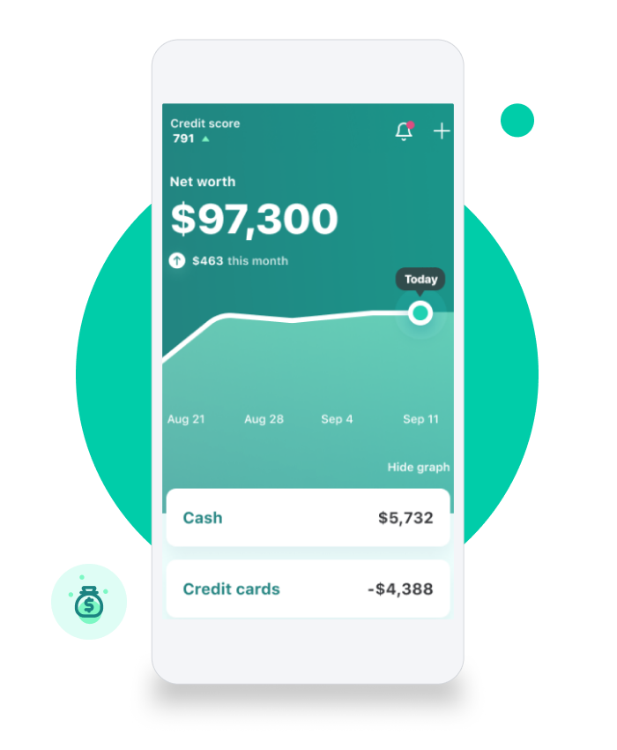
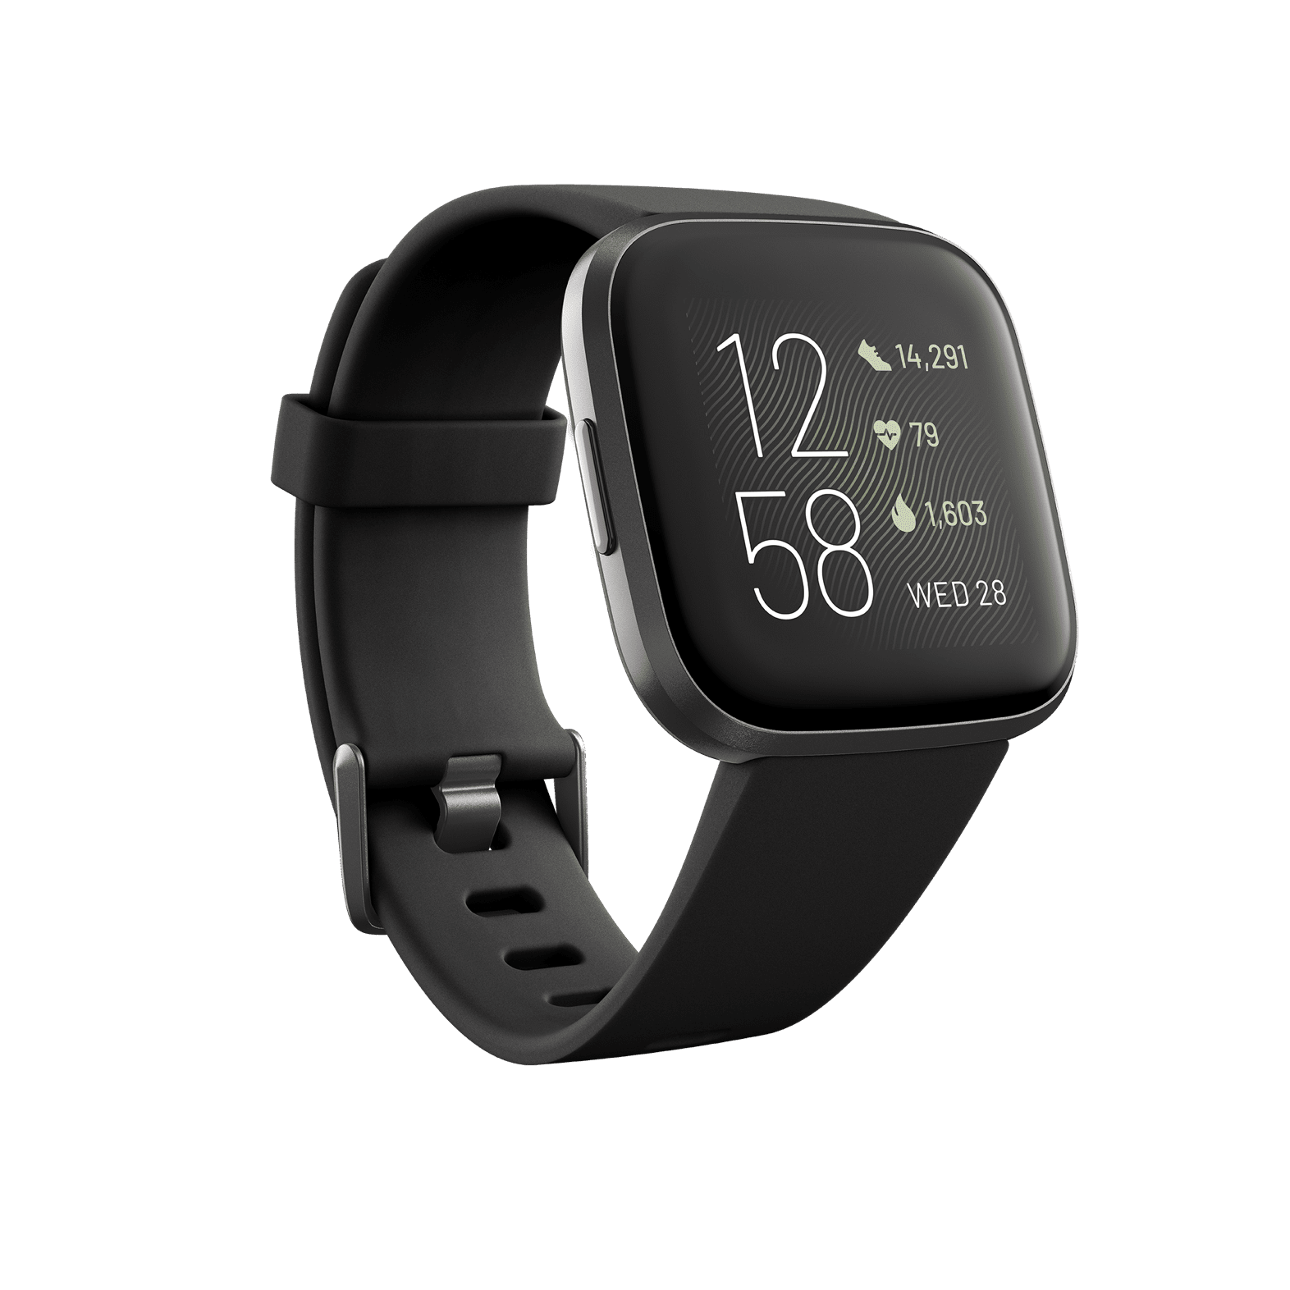
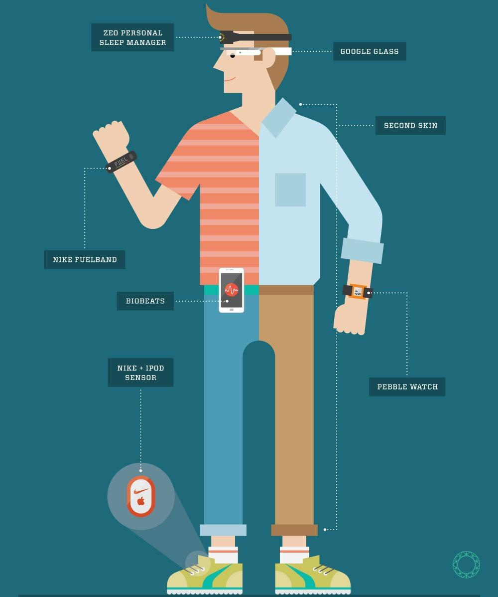
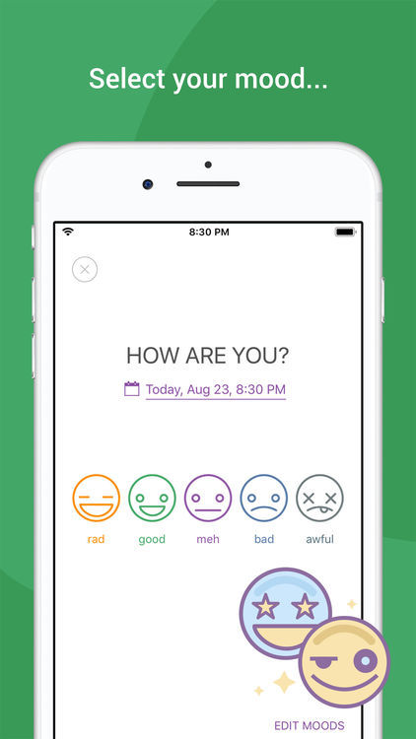

Personal Informatics
Notes:
Self-tracking, personal informatics, quantified self. Tracks both objective (largely via sensors) and subjective (via self-report).
https://www.google.com/url?sa=i&url=https%3A%2F%2Fwww.fitbit.com%2Fglobal%2Fus%2Fproducts%2Fsmartwatches%2Fversa&psig=AOvVaw3D6tG0EQGdw6c3hm4ArluP&ust=1638302835072000&source=images&cd=vfe&ved=0CAwQjhxqFwoTCOjztuavvvQCFQAAAAAdAAAAABAD
https://www.google.com/url?sa=i&url=https%3A%2F%2Ftechnori.com%2F2018%2F08%2F4281-the-beginners-guide-to-quantified-self-plus-a-list-of-the-best-personal-data-tools-out-there%2Fmarkmoschel%2F&psig=AOvVaw2D91lQMZzOHQ1xR0iacY4P&ust=1638302862070000&source=images&cd=vfe&ved=0CAwQjhxqFwoTCKCQtfSvvvQCFQAAAAAdAAAAABAD
https://www.google.com/url?sa=i&url=https%3A%2F%2Fmint.intuit.com%2F&psig=AOvVaw0jNtQUAQEkHRVOfhXYpZ-x&ust=1638302936030000&source=images&cd=vfe&ved=0CAwQjhxqFwoTCIip8JawvvQCFQAAAAAdAAAAABAD
https://www.google.com/url?sa=i&url=https%3A%2F%2Fwww.happierhuman.com%2Fbest-mood-tracker-apps%2F&psig=AOvVaw2Pa9KFjdSoazhX9Jk6auoD&ust=1638302906270000&source=images&cd=vfe&ved=0CAwQjhxqFwoTCNC4krGwvvQCFQAAAAAdAAAAABAD

Slide 4
Motivation
Personal informatics focuses largely on numbers
The “reflection” piece is often assumed or missing, not holistic
Design, build, deploy, and evaluate reflective personal informatics systems that support holistic reflection on the self, leading to self-knowledge and self-directed behavior change

Slide 5
Overview of Research: Personal Informatics
HCI research the intersection of:
Interactive Systems Design
Information Visualization
Cognitive science / psychology
Applied machine learning (particularly NLP)
Software Engineering
Publication Venues
ACM CHI
ACM Designing Interactive Systems (DIS)
IEEE VIS
ACM UbiComp

Slide 6
Agenda
Motivation and Research Direction
Previous Work
Mental Health, Dreaming, and Manufacturing
Dissertation Work
Personal Informatics for Understanding Needs and Self
AI-augmented self-tracking and flexible time tracking systems
Future Work
Technology and Spirituality
Community informatics and visualization
Lifestyle Recommender Systems
AI Alignment

Slide 7
Agenda
Motivation and Research Direction
Previous Work and “Side Projects”
Mental Health, Dreaming, Spirituality
Dissertation Work
Personal Informatics for Understanding Needs and Self
AI-augmented self-tracking and flexible time tracking systems
Future Work
Community informatics and visualization
Lifestyle Recommender Systems
AI Alignment

Slide 8
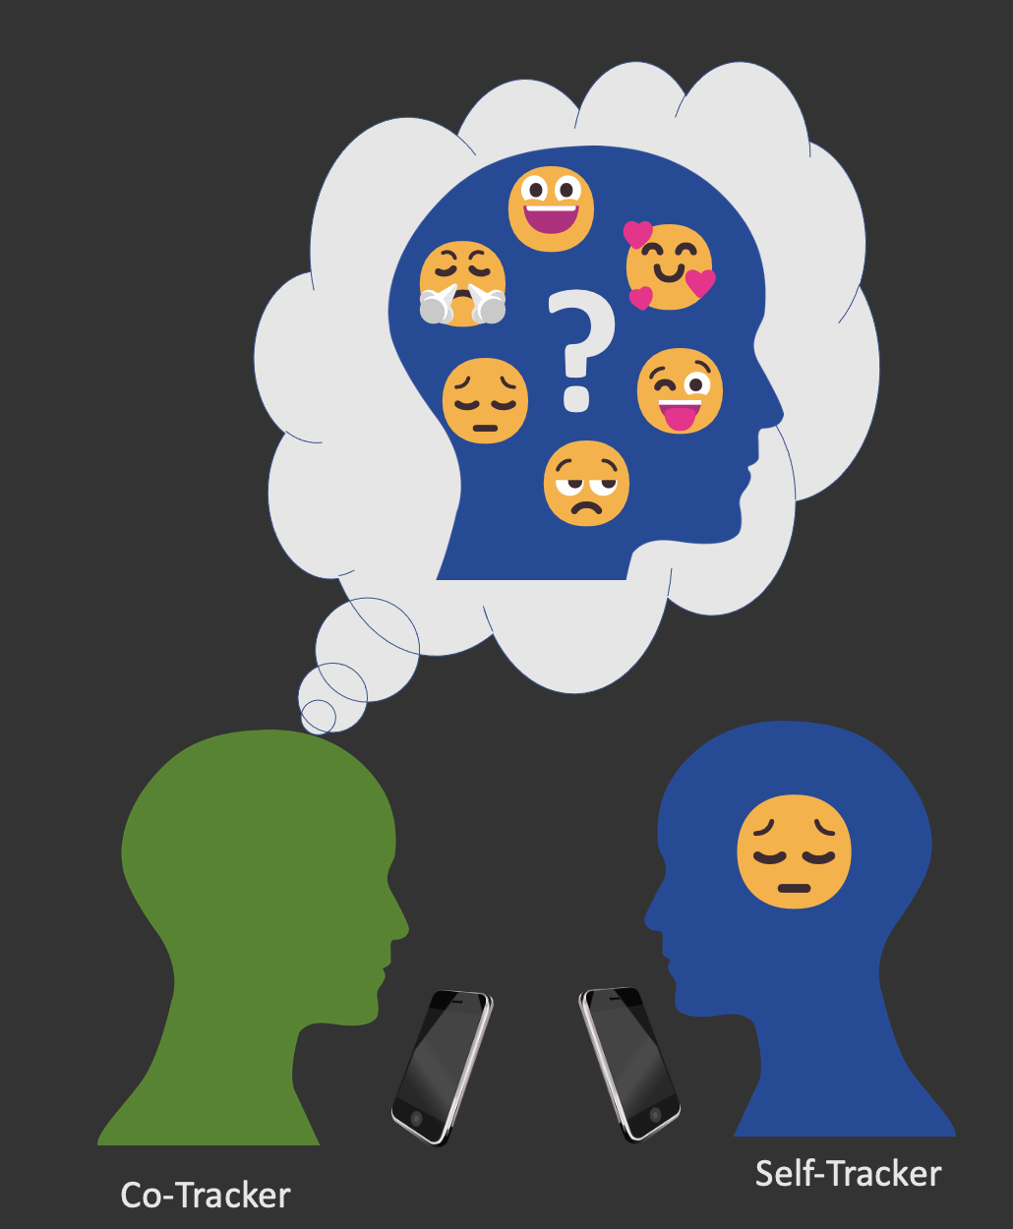
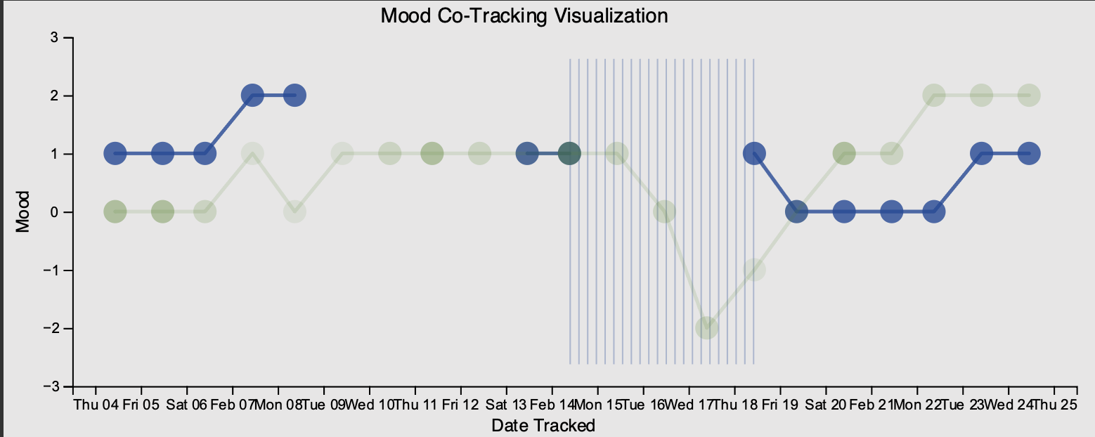
Collaborative Mood Tracking for Bipolar Disorder
Custom app to support two way mood tracking
Full paper published in DIS 2021, short paper at CHI 2022, poster at IEEE VIS

Slide 9
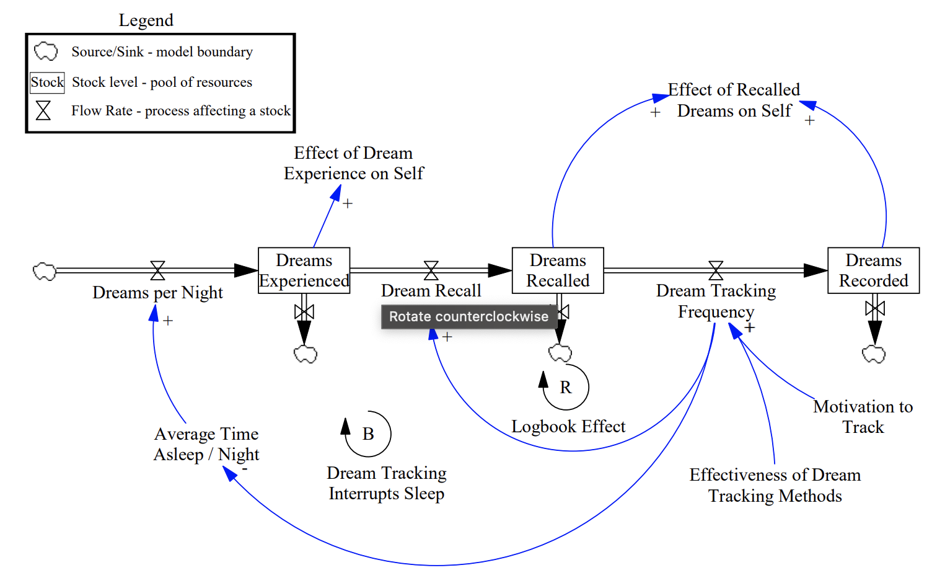
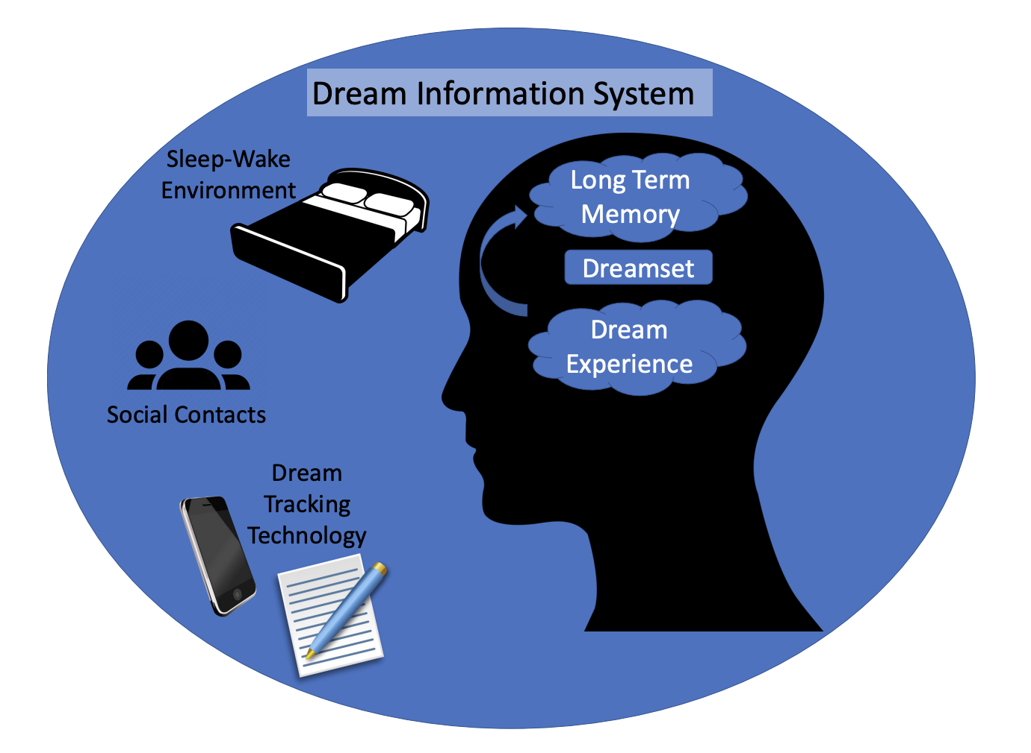
Personal Dream Informatics
Applying system dynamics to study personal information systems of dreaming
Full paper published in CHI 2022

Slide 10
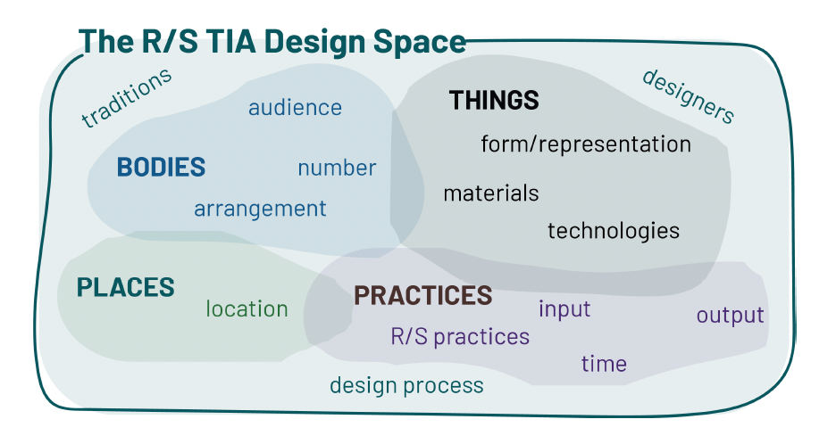
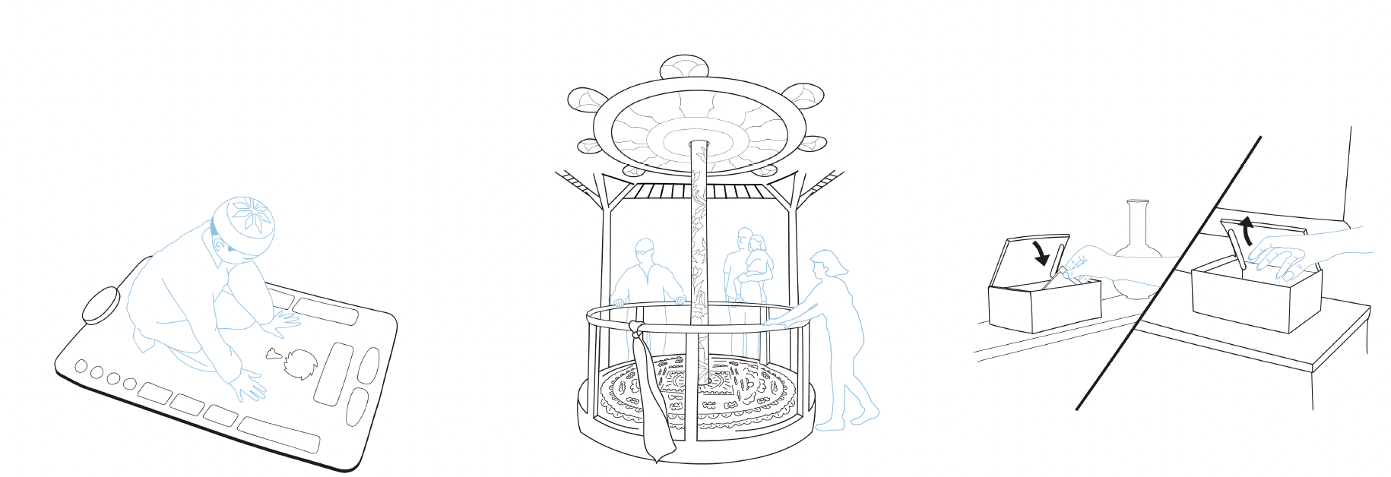
HCI in Faith, Religion, and Spirituality
Founding member of Spirited Collective, a group of researchers working at the intersection of faith, religion, and spirituality
Workshop at ACM DIS 2023
Full paper at ACM TEI 2024

Slide 11
Agenda
Motivation and Research Direction
Previous Work and “Side Projects”
Mental Health, Dreaming, Spirituality
Dissertation Work
Personal Informatics for Understanding Needs and Self
AI-augmented self-tracking and flexible time tracking systems
Future Work
Community informatics and visualization
Lifestyle Recommender Systems
AI Alignment

Slide 12

Motivation
“A point may soon be reached...when these [basic] needs are satisfied in the sense that we prefer to devote our further energies to non-economic purposes.”
Notes:
15 hour weeks

Slide 13
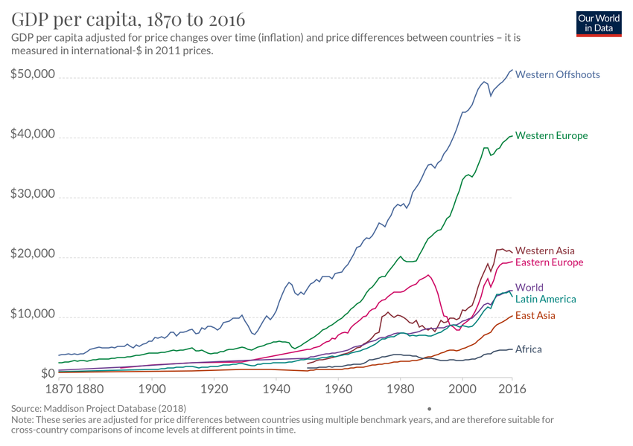

Slide 14
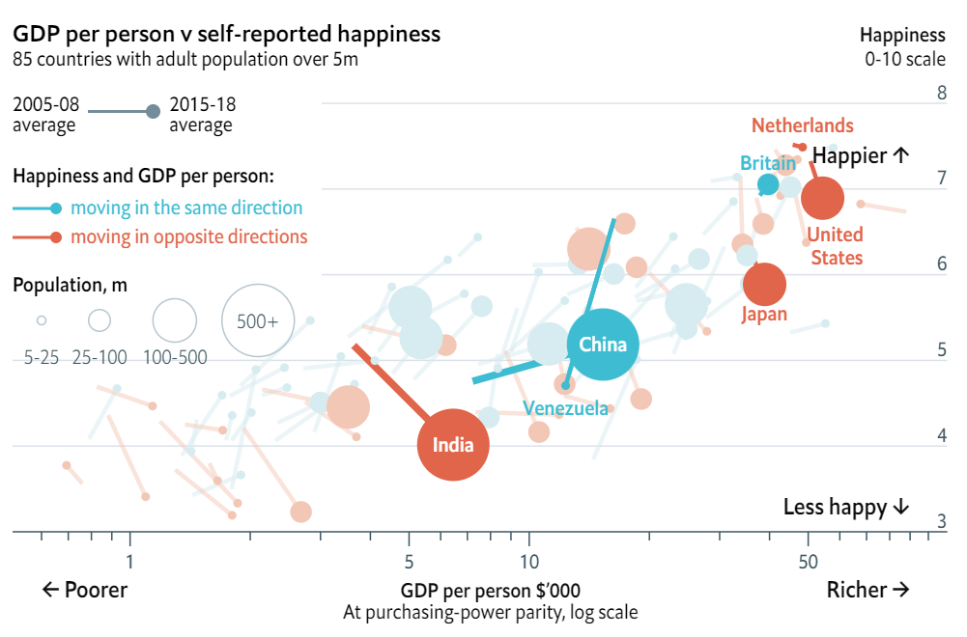
At some point, increasing GDP does not seem to increase “happiness”

Slide 15
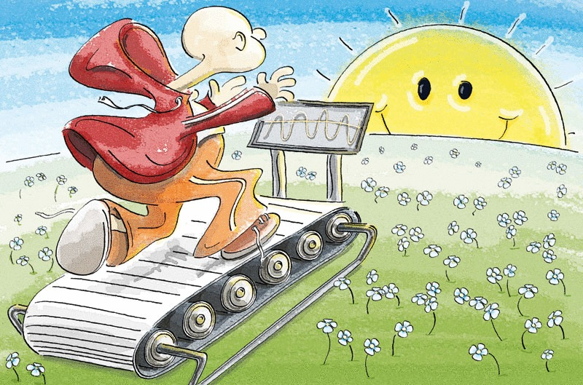
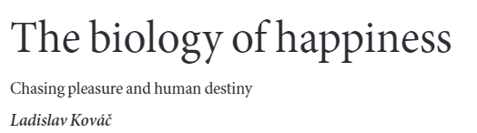

Slide 16

Challenge:
“Development that meets the needs of the present without compromising the ability of future generations to meet their own needs”

Slide 17
Research Question
How could a personal informatics system support data collection, visualization, and reflection on need and satisfaction in daily life?
Notes:
what’s our theory of need? Self-as-needs, self-as-consumption

Slide 18
Existing Approaches to Measuring Need/Satisfaction
Make sweeping assumptions about people and need satisfaction
Computational Approaches
Look at aggregate measures of economic activity and social indicators (economics)
Classify sentences from blog posts according to basic human need expressed (natural language processing)
Community Workshop Methods
Originally championed by Max-Neef
Community meetings to fill out matrices of satisfiers and inhibitors
Difficult to scale, not connected to “objective” data about life
Notes:
https://www.i4biz.com/best-practice/win-compete-top-maslows-hierarchy-needs/

Slide 19
Personal Informatics Approach
Scalable
Connected to lived experience
Potential to be “a mechanism for eliciting information on well-being directly from the population”
Salvatore Monni and Alessandro Spaventa. 2013. Beyond GDP and HDI: Shifting the focus from paradigms to politics. Development 56, 2 (June 2013), 227–231.
Notes:
https://www.i4biz.com/best-practice/win-compete-top-maslows-hierarchy-needs/

Slide 20
Study Design
Tech probe design
10 participants in a think-aloud
7 in week long deployment
Closing interview with interactive visualization dashboard
For one week, participants collected:
What they did
Where
Who they were with
Organization involved
Needs satisfied
Self-aspects activated
Notes:
what’s our theory of need? Self-as-needs, self-as-consumption

Slide 21
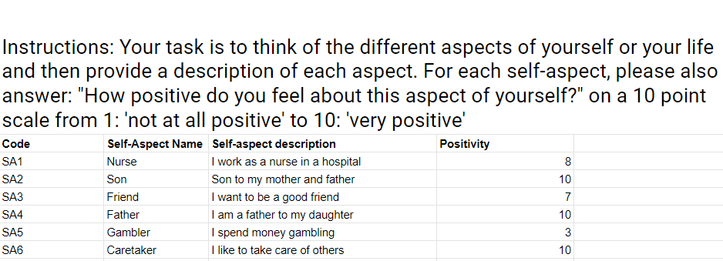
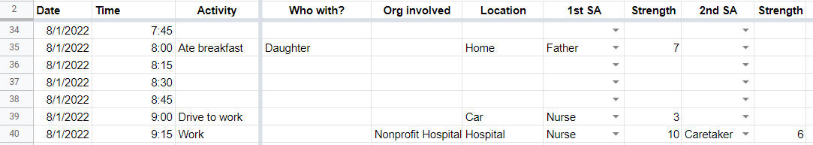
Probe Design
Notes:
what’s our theory of need? Self-as-needs, self-as-consumption

Slide 22
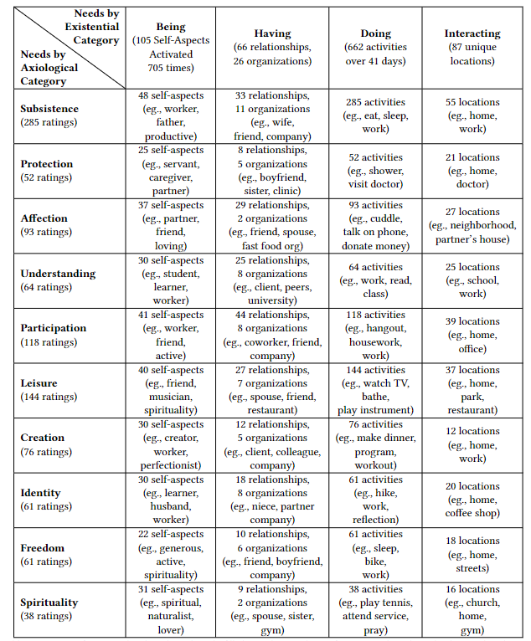
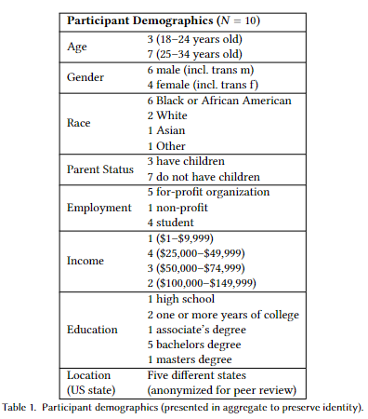
Results
Notes:
what’s our theory of need? Self-as-needs, self-as-consumption

Slide 23
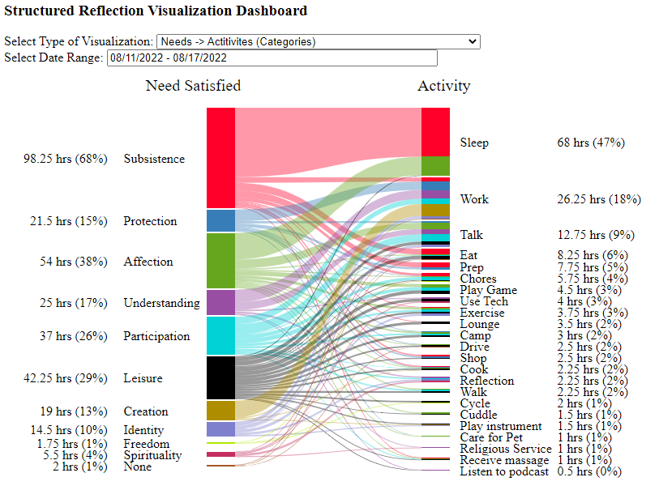
Reflection Dashboard
Notes:
what’s our theory of need? Self-as-needs, self-as-consumption

Slide 24
Self-Reported Benefits to Participants
“This study has been quite a journey sometimes. My experience with this study has been fascinating…I do stuff without even knowing it. Seeing this chart and all, and seeing what I do, it feels like I don't do much. It's kind of fascinating that I spend most of the time being alone, just working, watching TV…to see that me being alone is 60-70% of my time…is quite fascinating to me.” -P7
“I had daughter as one of my self-aspects, but in this week I did nothing to contribute to this… which may mean that I need to… updating my family on how I'm doing and like, asking that in return” –P10
All participants reported learning something about themselves
About half of participants reported wanting to change how they were living
All participants expressed interest in continuing to use the system at some frequency

Slide 25
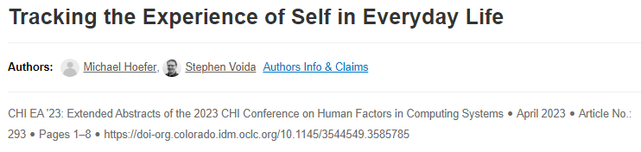
Contributions of Study
First attempt at collecting need satisfaction data via personal informatics system
Network data model for representing need data
Improved understanding of how people think about need satisfaction and self-aspect activation
New methods for designing interactive systems
Day Reconstruction Method to provide a complete record of time use
Using the multiple self-aspects to scaffold reflection
Network visualization of the self

Slide 26
Study 1 Insights
Participants had trouble completing the time tracking activity
They wanted to “just talk about their day”

Slide 27
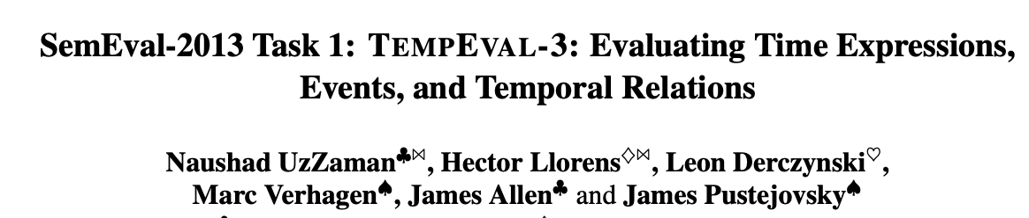
Human-AI Collaboration for Self-Tracking
Advances in large language models (LLMs) make challenging NLP tasks easier
Now possible to extract a structured list of events from a spoken/written narrative
How can LLMs help individuals to gather data about their lives?

Slide 28
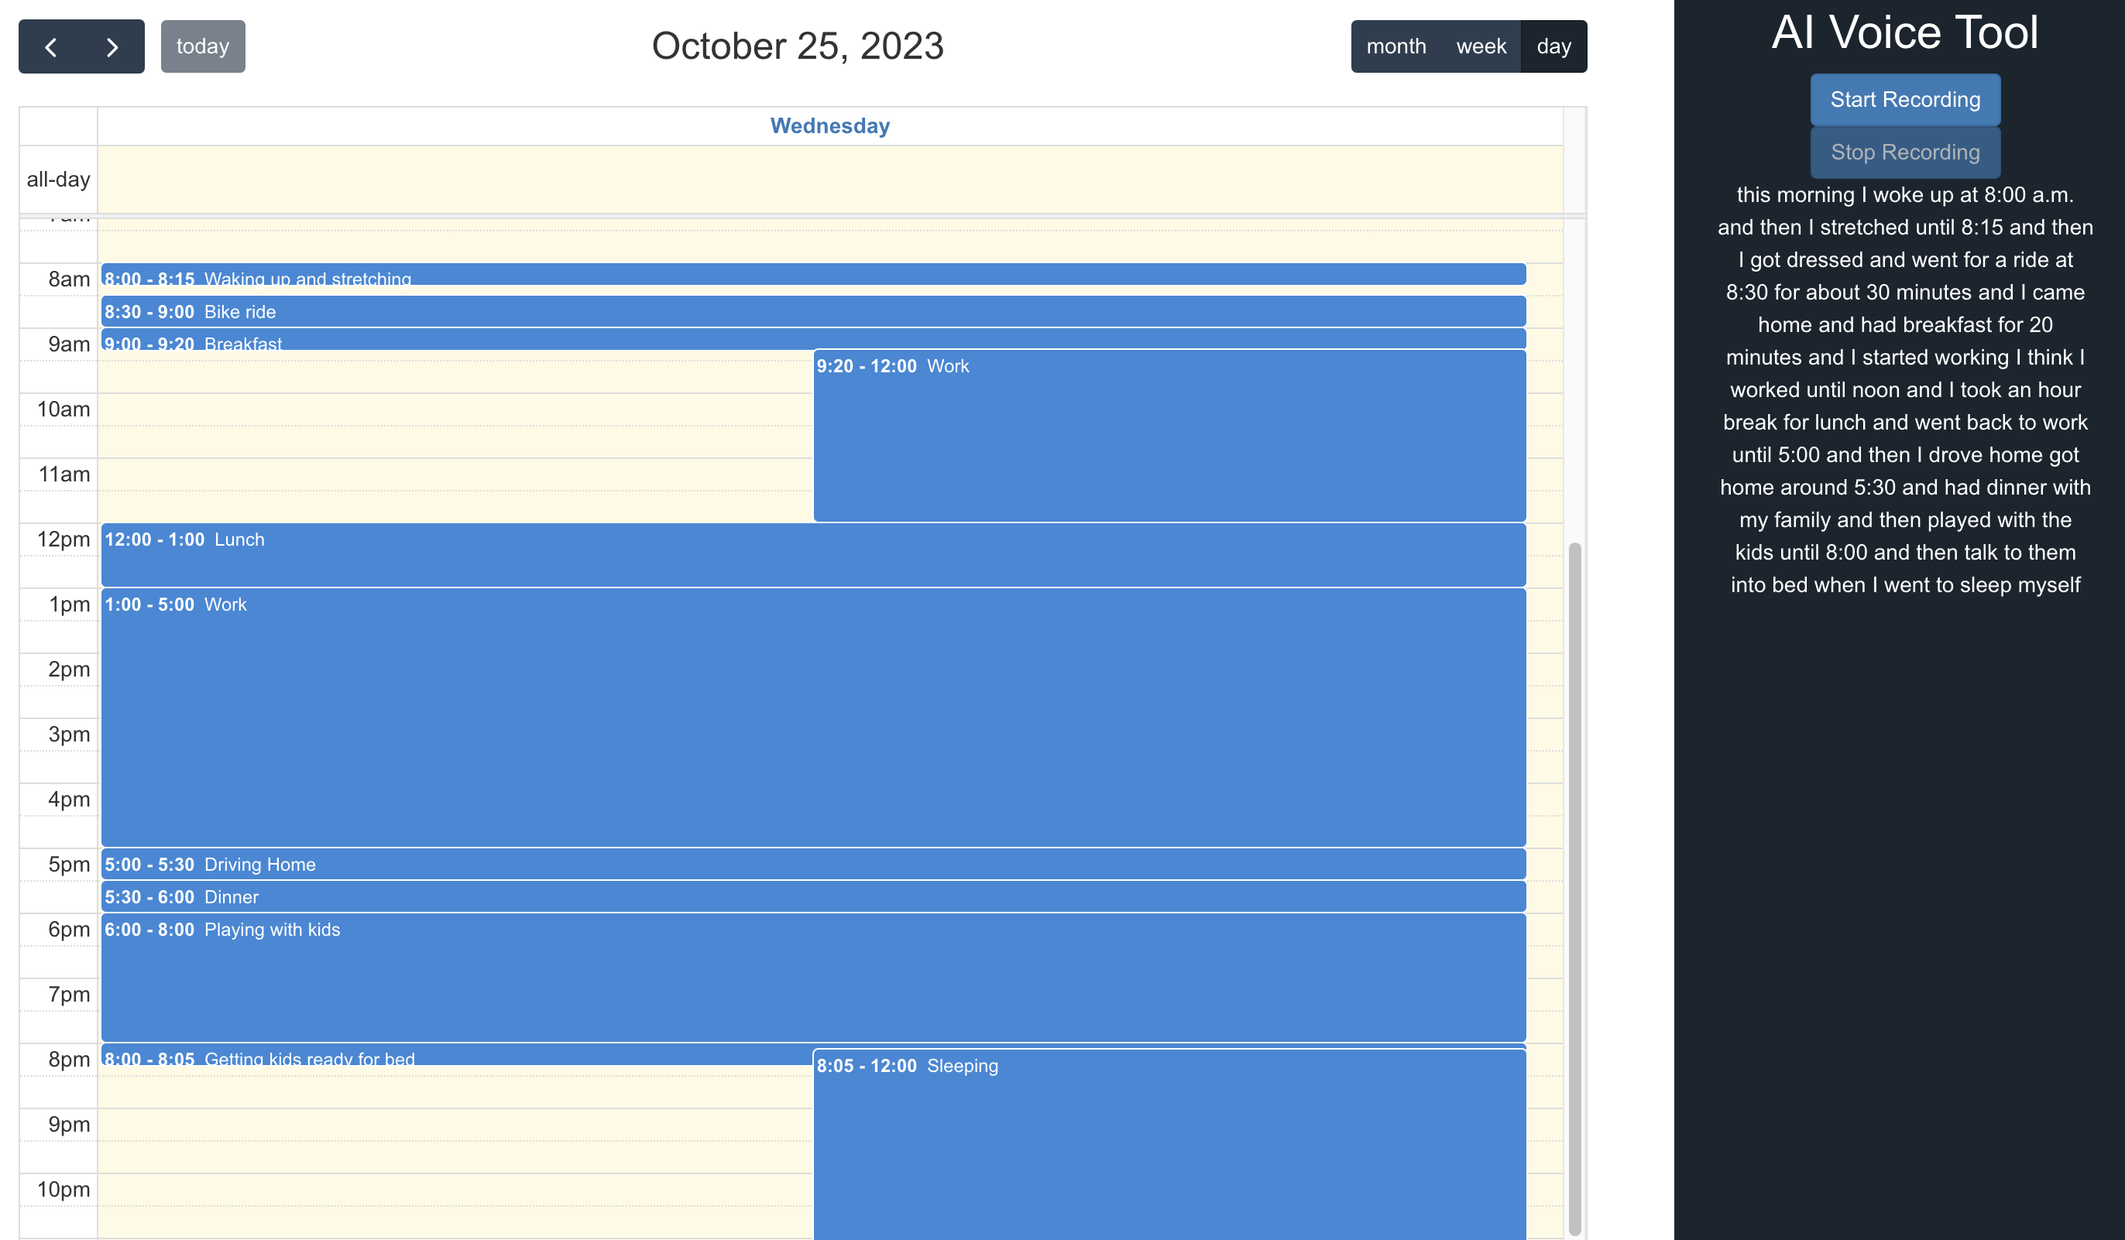
AI-Powered Calendar Interface

Slide 29

Study Design and Contributions
Think-aloud and data log study to understand how individual interact with an AI conversational agent for collective time-use data
RCT to compare regular interface with AI-augmented interface
Understand limitations of current LLMs, and the mutual co-learning between the LLM and the individual
New data collection methodology for time use

Slide 30
Flexible Self-Tracking for Time Use
Study 1 focused on a specific theory of needs (Max-Neef’s)
New system under development that allows for user-defined sets of “values,” such as:
Maslow’s Hierarchy of needs
Time spent in flow
Mood state
7 deadly sins
Self-aspects
Planning a longitudinal deployment study to understand user experience and resulting lifestyle changes

Slide 31
Flexible Self-Tracking for Time Use
Study 1 focused on a specific theory of needs (Max-Neef’s)
New system under development that allows for user-defined sets of “values,” such as:
Maslow’s Hierarchy of needs
Time spent in flow
Mood state
7 deadly sins
Self-aspects
Planning a longitudinal deployment study to understand user experience and resulting lifestyle changes

Slide 32
Agenda
Motivation and Research Direction
Previous Work and “Side Projects”
Mental Health, Dreaming, Spirituality
Dissertation Work
Personal Informatics for Understanding Needs and Self
AI-augmented self-tracking and flexible time tracking systems
Future Work
Community informatics and visualization
Lifestyle Recommender Systems
AI Alignment

Slide 33
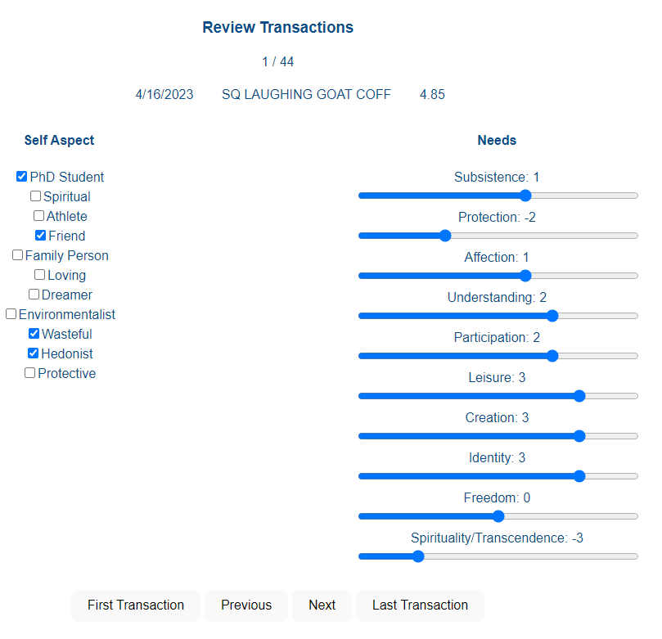
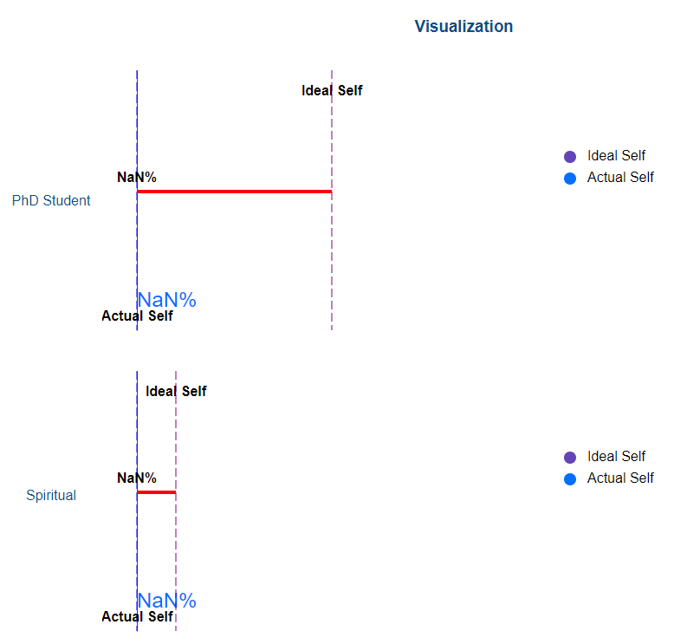
Future Work – Reflection on Money Use
Money is a signal of economic production, and therefore environmental impact

Slide 34
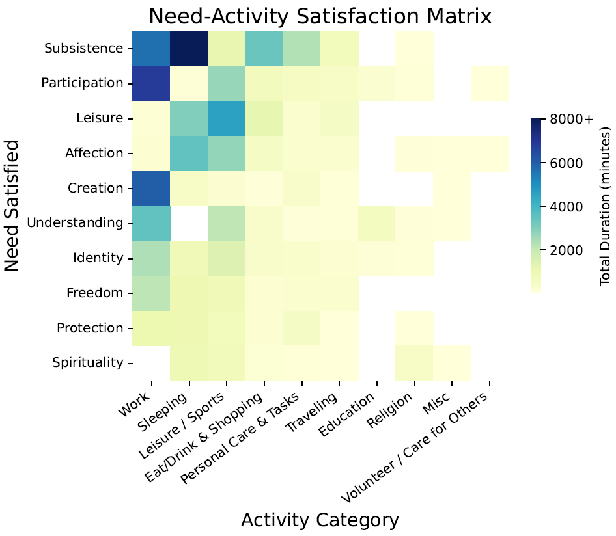
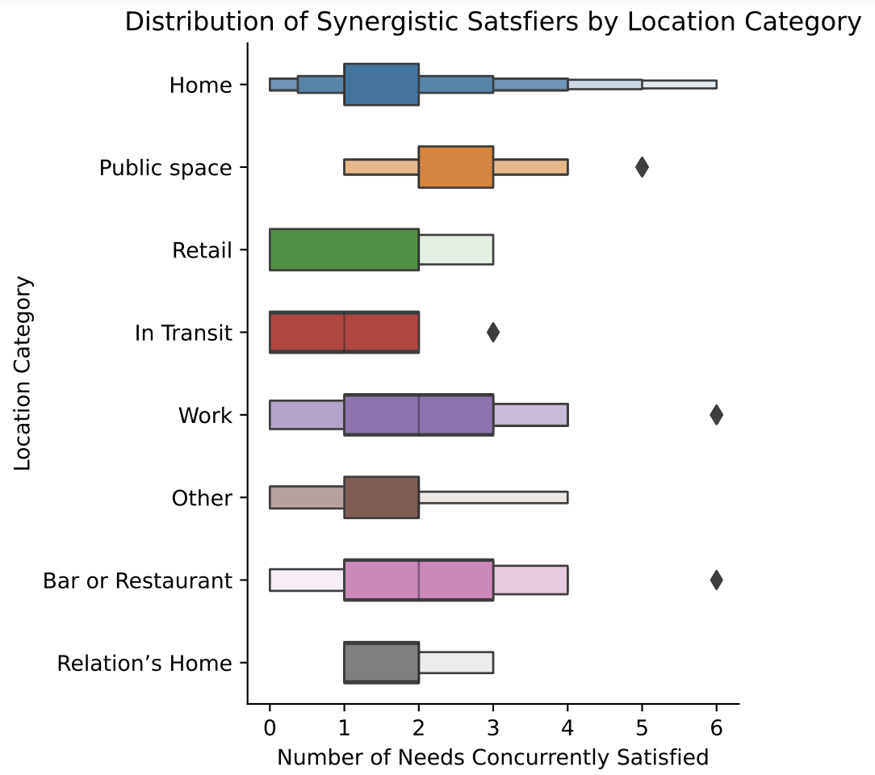
Future Work – Community Informatics
Analyzing aggregate data may inform social policy making

Slide 35
Future Work – Lifestyle Recommender Systems
Participants were interested in sharing visualizations with others
Studies to explore sharing lifestyle visualizations with both relations and strangers
Digitally mediated empathy
Lifestyle recommendations from humans and AI

Slide 36
Future Work – AI Alignment
Digital representations of human lives and lifestyles
May serve an important role in AI alignment, ensuring that lifestyles and values of humans are not disrupted

Slide 37
Conclusion
Building new personal informatics systems that help individuals learn about themselves
Gathering new types of data for understanding relationships between lifestyle choices and values/needs
Research in HCI, at the intersection of design, visualization, psychology, and applied ML

Slide 38
Funding Opportunities
NSF → CISE Directorate → IIS Division → Human-Centered Computing (HCC) Program
Templeton Foundation → Religion, Science, and Society Area

Slide 39
Connections to Pedagogy
Diversity of research experience helps provide examples to intro computing students
Specific methods taught in HCI courses
Project focused active learning
Overarching intention: teaching computer science with the end in mind, computing for social good

Slide 40
Opportunities for Undergraduate Involvement
Interdisciplinary work allows for students to engage in reseach via:
Psychology/cognitive science (study design)
Systems Building
Software engineering and cloud computing
Database design and data modeling
UI/UX design
Human centered computing (conducting studies)
Data science (analysis of study data/system usage)

Slide 41
Potential Collaborations
Dr. Tommy Marrinan – virtual reality
Dr. Amelia McNamara – visualization design
Dr. Ryan Hardt – software engineering and HCI

Slide 42


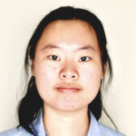
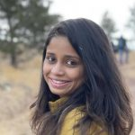







Collaborators
M.S. Students
PhD Collaborators
Raegan Rychecky
Angel Dong
Namratha
Mysore Keshavaprakash
Tian Xu
Dr. Janghee Cho
Undergraduate Students
Advisor
Bryce Schumacher
Jackson Billelo
Anusha Venkateswaran
Lizzie Bartholomew
Dr. Stephen Voida

Slide 43

Thank you!
Michael Hoefer
michael.hoefer@colorado.edu
www.michaelhoefer.com
Research Goal: Design, build, deploy, and evaluate reflective personal informatics systems that support holistic reflection on the self, leading to self-knowledge and self-directed behavior change

Slide 44
Dissertation RQ:
How can personal informatics systems be designed to help understand and support human need satisfaction and human values in the context of time-use and money-use in daily life?

Slide 45
Dissertation Goals:
Design technology that directs attention in useful ways for supporting “the art of living”
Aligning lifestyles with values/needs
Create representations of the self and lived experience that are useful individually, interpersonally, and in aggregate at various scales
Learn how people think about their daily life in the context of time-use and money-use
Notes:
Art of Living – Dodds, 1997

Slide 46
Background and Related Work
Research Approach
Value-Aligning Personal Informatics
Study 1 – Understanding Human Need
Study 2 – Personal Financial Informatics
Study 3 – Empathy Viz Survey
Timeline and Discussion

Slide 47
Background and Related Work
Research Approach
Value-Aligning Personal Informatics
Study 1 – Understanding Human Need
Study 2 – Personal Financial Informatics
Study 3 – Empathy Viz Survey
Timeline and Discussion

Slide 48
Motivation
“A point may soon be reached...when these [basic] needs are satisfied in the sense that we prefer to devote our further energies to non-economic purposes.”
Notes:
15 hour weeks

Slide 50
At some point, increasing GDP does not seem to increase “happiness”

Slide 52
Challenge:
“Development that meets the needs of the present without compromising the ability of future generations to meet their own needs”

Slide 53
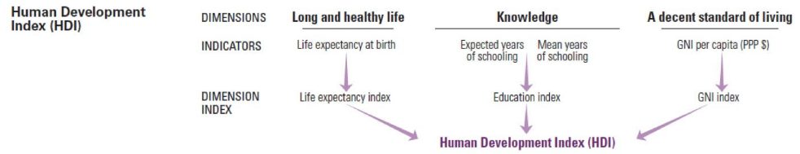
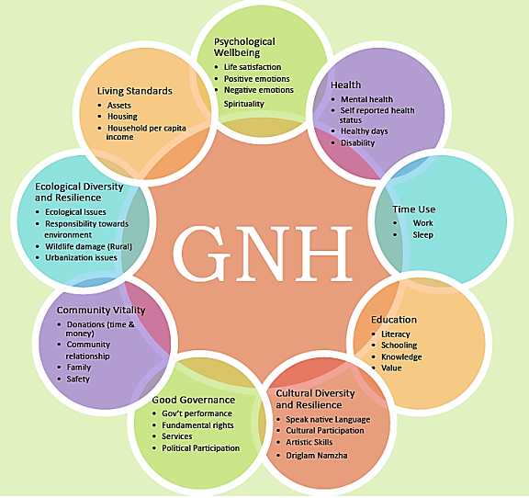
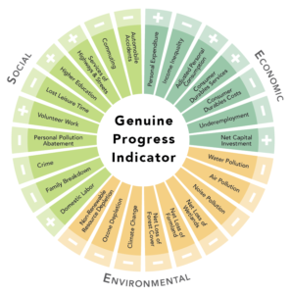
Alternative Development Metrics
Issues:
Inherent tradeoffs
Single numbers become meaningless
Provide little to no direction for improvement
Notes:
https://gnhusa.org/genuine-progress-indicator/

Slide 54
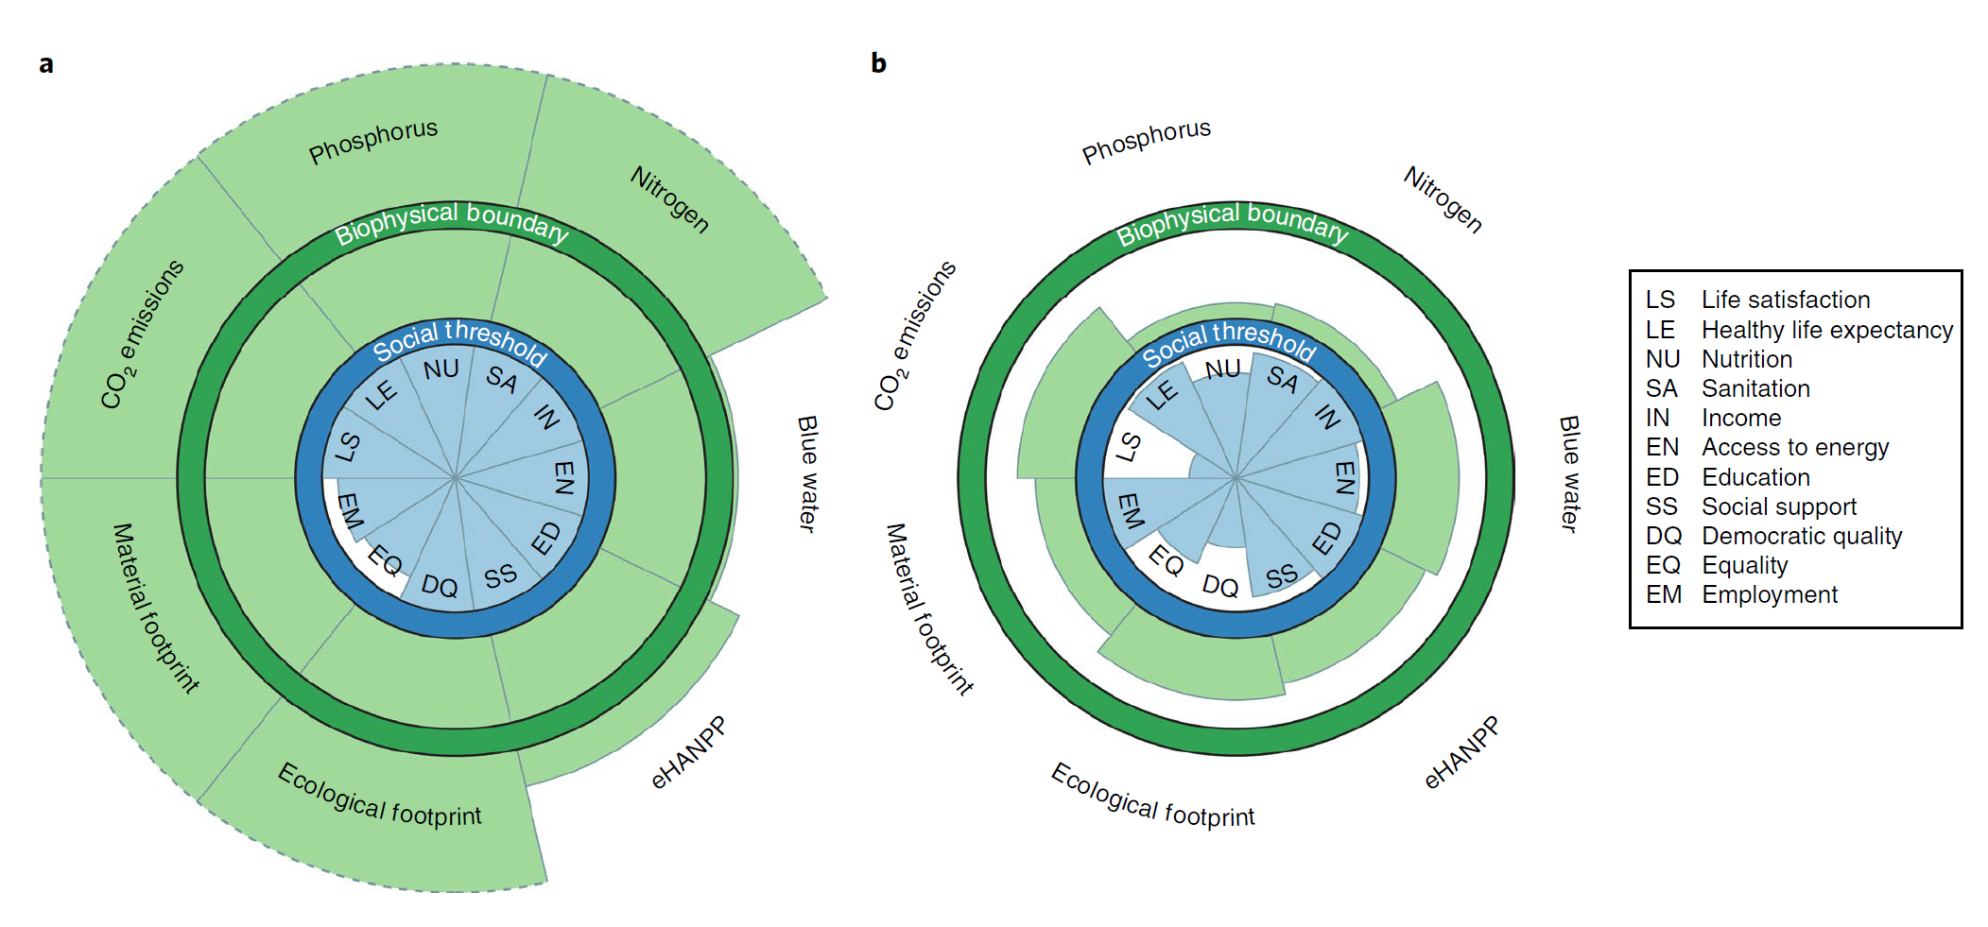
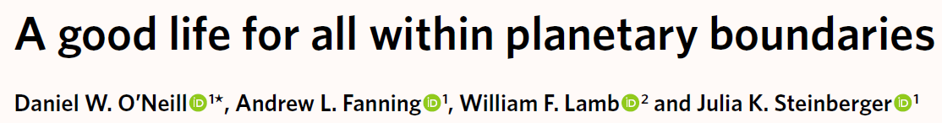
Sustainable Consumption Corridors

Slide 55
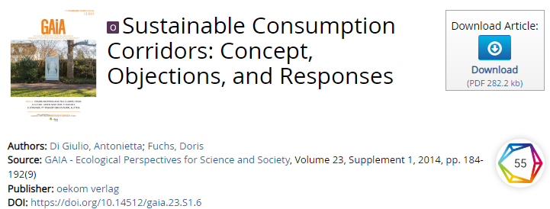
Sustainable Consumption Corridors:
Key open challenges for operationalizing consumption corridors:
“potential strategies for the design”
“definition and implementation of such corridors”
Need implementation-focused theory to operationalize consumption corridors

Slide 56
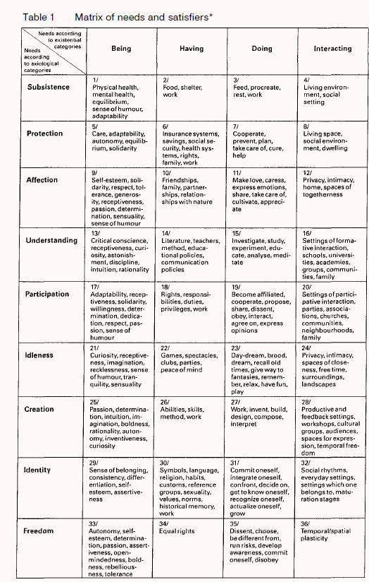
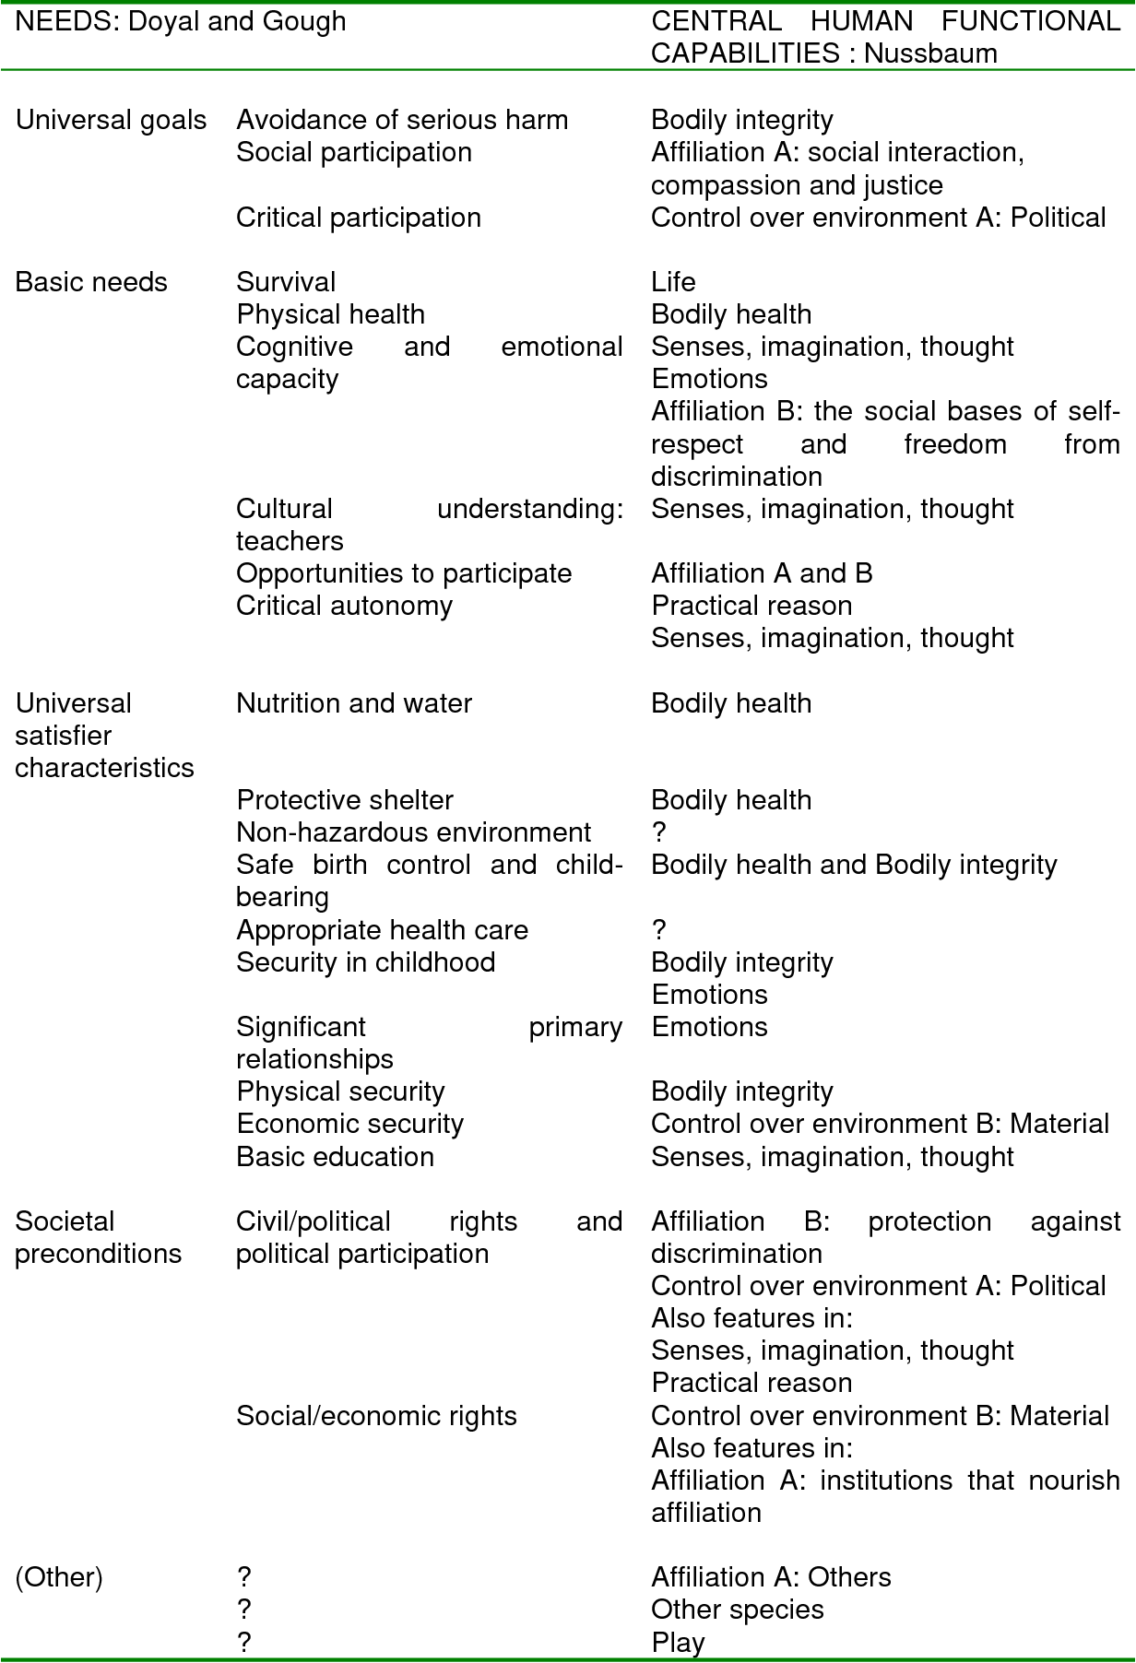
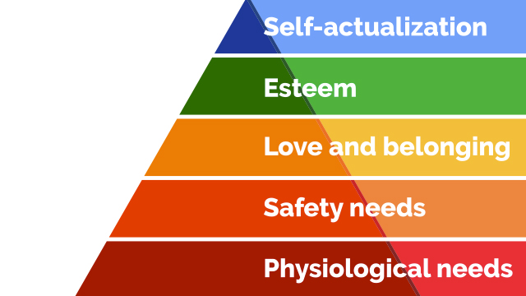
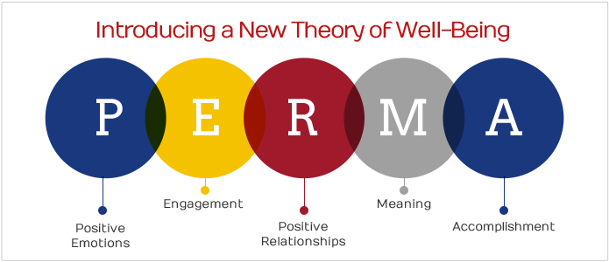
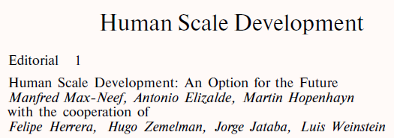
What are human needs?
Nobody seems to agree
Notes:
https://www.i4biz.com/best-practice/win-compete-top-maslows-hierarchy-needs/

Slide 57
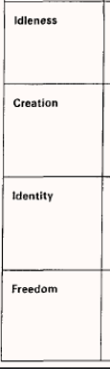
Max-Neef’s Theory
Set of 9 (later 10) “universal” needs
Popular in sustainability research
Distinguished between “need” and “satisfier”
Existential categories of needs
Being
Having
Doing
Interacting
Notes:
https://www.i4biz.com/best-practice/win-compete-top-maslows-hierarchy-needs/

Slide 58
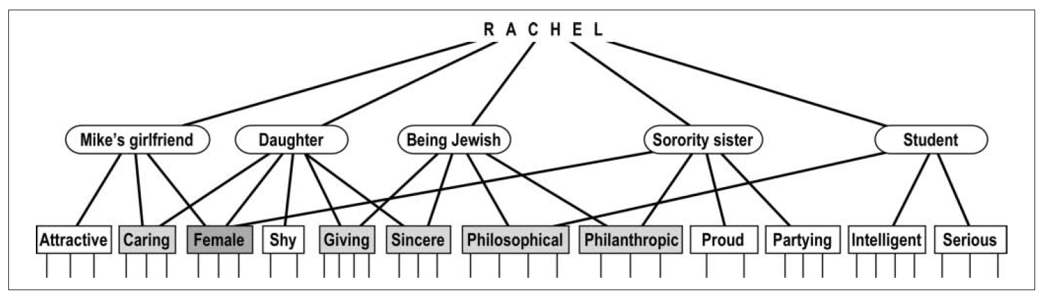
Being: Multiple Self-Aspects Theory
Self-concept composed of multiple interdependent “self-aspects”
From psychology: self-aspect elicitation exercises
Notes:
https://www.i4biz.com/best-practice/win-compete-top-maslows-hierarchy-needs/

Slide 59
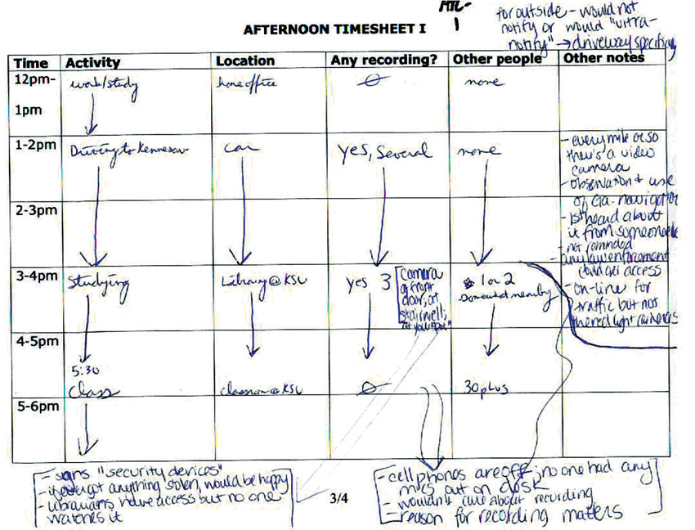
Doing: Kahneman's Day Reconstruction Method
Intermediate method between experience sampling and retrospective report, but results in a complete record of the day
Focus on episodic memory recall
Notes:
Massimi, Michael & Truong, Khai & Dearman, David & Hayes, Gillian. (2010). Understanding Recording Technologies in Everyday Life. Pervasive Computing, IEEE. 9. 64 - 71. 10.1109/MPRV.2009.89.
Kahneman D, Krueger AB, Schkade DA, Schwarz N, Stone AA. A survey method for characterizing daily life experience: the day reconstruction method. Science. 2004 Dec 3;306(5702):1776-80. doi: 10.1126/science.1103572. PMID: 15576620.

Slide 60
Having and Interacting
Having: relationships and organizations
People co-present
Involved organization
Interacting: Locations
Deeply aligned with Transition Design at CMU
Notes:
https://www.i4biz.com/best-practice/win-compete-top-maslows-hierarchy-needs/

Slide 61
Network Model of Needs
Two entities (needs and satisfiers)
+ complex relationships between needs and satisfiers
→ bipartite network representation of an individual’s needs (need landscape)
Notes:
what’s our theory of need? Self-as-needs, self-as-consumption

Slide 62
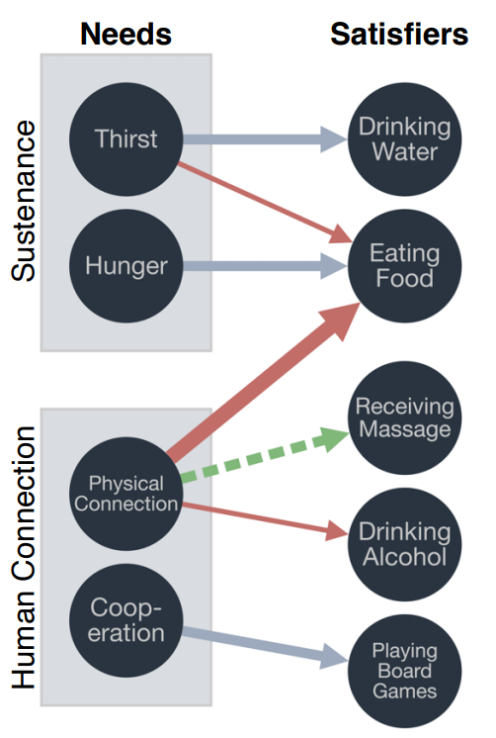
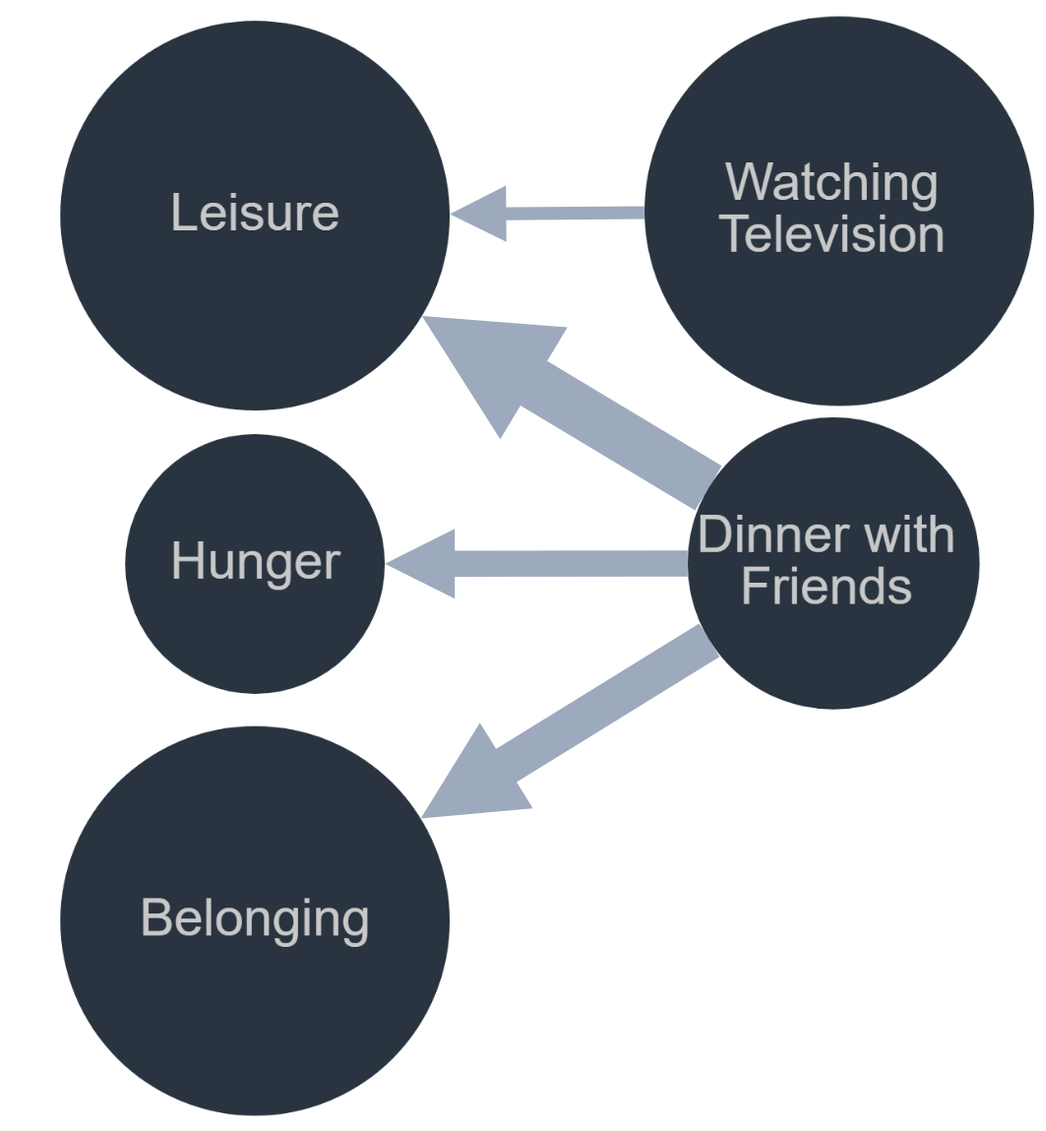
Network Model of Needs
Notes:
https://www.i4biz.com/best-practice/win-compete-top-maslows-hierarchy-needs/

Slide 63
Self-Awareness Theory
When awareness directed to the self, inconsistencies become salient
Leads to discomfort, leading to change
Duval, S., & Wicklund, R. A. (1972). A theory of objective self awareness. Academic Press.
Notes:
https://www.i4biz.com/best-practice/win-compete-top-maslows-hierarchy-needs/

Slide 64
Background and Related Work
Research Approach
Value-Aligning Personal Informatics
Study 1 – Understanding Human Need
Study 2 – Personal Financial Informatics
Study 3 – Empathy Viz Survey
Timeline and Discussion

Slide 65
Research Approach
My current thinking: information about well-being is only really known by the individual being “measured”
Must ask individuals
Approach: create useful technology that will be helpful to the individual
Otherwise, little hope of collecting the information
Personal informatics systems use data from everyday life to support these measurements (reflection)
Notes:
https://www.i4biz.com/best-practice/win-compete-top-maslows-hierarchy-needs/

Slide 66
Personal Informatics Research Approach
Global reflection about the self
Collect “objective” data about daily life
Direct attention of participants to annotate specific quanta of daily life
Time use and money use
Interact with visualizations comparing global reflection with aggregated reflections on daily life
Notes:
Time and money use are universal

Slide 67
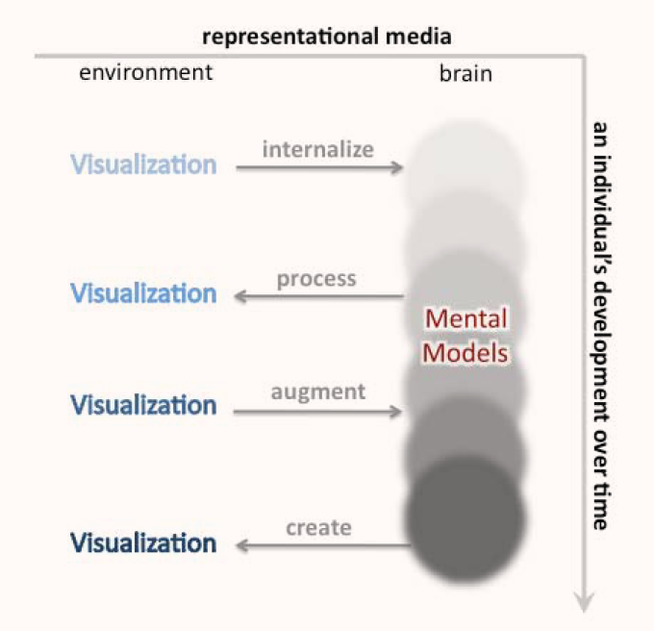
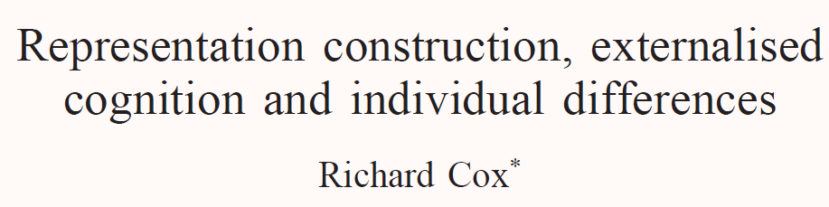

Reciprocal Feedback Loops
Visualizations and mental models inform and construct each other
We form mental models of the visualizations
So what would it mean if we visualize ourselves?

Slide 68
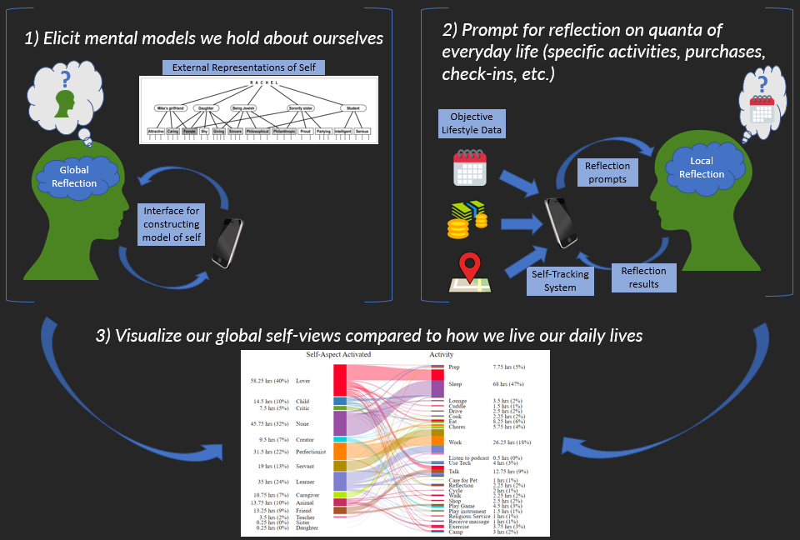
Framework for Reflection on Everyday Life

Slide 69


Framework for PI and Self-Development
Confront mental models with viz
External Representation(s) of Self
Reflection
Visualization
Reflection prompts
Reflection results
PI System
Objective data about life

Slide 70
Background and Related Work
Research Approach
Value-Aligning Personal Informatics
Study 1 – Understanding Human Need
Study 2 – Personal Financial Informatics
Study 3 – Empathy Viz Survey
Timeline and Discussion

Slide 71
Research Questions
How could a personal informatics system support data collection, visualization, and reflection on need and satisfaction in daily life?
Notes:
what’s our theory of need? Self-as-needs, self-as-consumption

Slide 72
Existing Approaches to Measuring Need/Satisfaction
Make sweeping assumptions about people and need satisfaction
Computational Approaches
Look at aggregate measures of economic activity and social indicators (economics)
Classify sentences from blog posts according to basic human need expressed (natural language processing)
Community Workshop Methods
Originally championed by Max-Neef
Community meetings to fill out matrices of satisfiers and inhibitors
Difficult to scale, not connected to “objective” data about life
Notes:
https://www.i4biz.com/best-practice/win-compete-top-maslows-hierarchy-needs/

Slide 73
Personal Informatics Approach
Scalable
Connected to lived experience
Potential to be “a mechanism for eliciting information on well-being directly from the population”
Salvatore Monni and Alessandro Spaventa. 2013. Beyond GDP and HDI: Shifting the focus from paradigms to politics. Development 56, 2 (June 2013), 227–231.
Notes:
https://www.i4biz.com/best-practice/win-compete-top-maslows-hierarchy-needs/

Slide 74
Study Design
Tech probe design
10 participants in a think-aloud
7 in week long deployment
Closing interview with interactive visualization dashboard
For one week, participants collected:
What they did
Where
Who they were with
Organization involved
Needs satisfied
Self-aspects activated
Notes:
what’s our theory of need? Self-as-needs, self-as-consumption

Slide 75
Probe Design
Notes:
what’s our theory of need? Self-as-needs, self-as-consumption

Slide 76
Results
Notes:
what’s our theory of need? Self-as-needs, self-as-consumption

Slide 77
Reflection Dashboard
Notes:
what’s our theory of need? Self-as-needs, self-as-consumption

Slide 78
Participants Seemed to Benefit from the Study
“This study has been quite a journey sometimes. My experience with this study has been fascinating…I do stuff without even knowing it. Seeing this chart and all, and seeing what I do, it feels like I don't do much. It's kind of fascinating that I spend most of the time being alone, just working, watching TV…to see that me being alone is 60-70% of my time…is quite fascinating to me.” -P7
“I had daughter as one of my self-aspects, but in this week I did nothing to contribute to this… which may mean that I need to… updating my family on how I'm doing and like, asking that in return” –P10
All participants reported learning something about themselves
About half of participants reported wanting to change how they were living
All participants expressed interest in continuing to use the system at some frequency

Slide 79
Challenges of Operationalizing “Need” Construct
Different timescales of satisfaction (subsistence vs. identity)
Different ideas about what meets a need
Compare to ideal situation
Emotional tone
Response of others
Flexibility of single activities to meet a variety of needs
Showering
Overall, participants felt Max-Neef’s set of needs was comprehensive

Slide 80
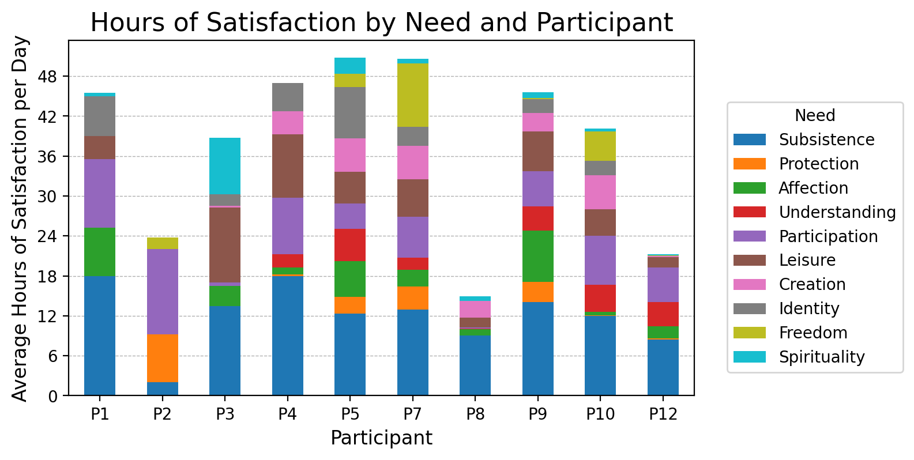
Collective Results
Notes:
what’s our theory of need? Self-as-needs, self-as-consumption

Slide 81
Contributions of Study 1
First attempt at collecting need satisfaction data via personal informatics system
Improved understanding of how people think about need satisfaction and self-aspect activation
New methods for designing interactive systems
Day Reconstruction Method to provide a complete record of time use
Using the multiple self-aspects to scaffold reflection
Network visualization of the self

Slide 82
Future Work Related to Study 1
Present aggregate data visualizations
Journal of Computing and Sustainable Societies
Develop and release prototype
Working with three masters students to develop the system

Slide 83
Background and Related Work
Research Approach
Value-Aligning Personal Informatics
Study 1 – Understanding Human Need
Study 2 – Personal Financial Informatics
Study 3 – Empathy Viz Survey
Timeline and Discussion

Slide 84
From Time to Money
While we asked people to report on spending, very low participation in study 1
Money is a more clear “signal” of consumption from an individual to the productive economy
Study 2 designed to explicitly address spending

Slide 85
Money in HCI
Limited work on money in HCI
Almost no personal informatics literature about personal financial informatics

Slide 86
Rokeach on Values
Values are
“cognitive representations and transformations of needs”
“the standards for evaluating oneself as well as others”
Rokeach Values Survey (RVS) well validated instrument
Iterated on by Schwartz in the Schwartz Values Survey (SVS)
Milton Rokeach, The nature of human values. 1973
Shalom Schwartz, “Universals in the Content and Structure of Values: Theoretical Advances and Empirical Tests in 20 Countries”, 1992
Notes:
https://www.i4biz.com/best-practice/win-compete-top-maslows-hierarchy-needs/

Slide 87
Study 2 Research Questions
How can technology support value-centered reflection on financial transactions, leading to self-knowledge and motivation for behavior change?
2a. How do individuals assign value-ratings to their financial transactions?
2b. How do aggregated value-ratings of individual transactions compare to global value preferences?
2c. How do individuals respond to seeing visualizations comparing their global value preferences with their aggregated value-ratings of financial transactions?

Slide 88
Framework for Reflection on Everyday Life

Slide 89
Study 2 Methodology
Technology probe deployment
Individuals download their transaction data from Mint.com
Annotate each transaction with one of the following (discussion point)
Needs satisfied
Self-aspects activated
Values “reified” or “supported”
Individuals suggest their “ideal self” spending
Data is aggregated and presented to highlight discrepancies between current and ideal self

Slide 90
Study Details
Recruit 10-15 users of Mint.com
They will already have financial data available
Download data and complete a “screening” to ensure it’s an accurate record of spending
Perform the self-aspect elicitation exercise (or a values survey instrument)
Annotate each transaction
Construct the “ideal self” by assigning percentages of budget to different needs/values/aspects
View visualizations and share insights

Slide 91
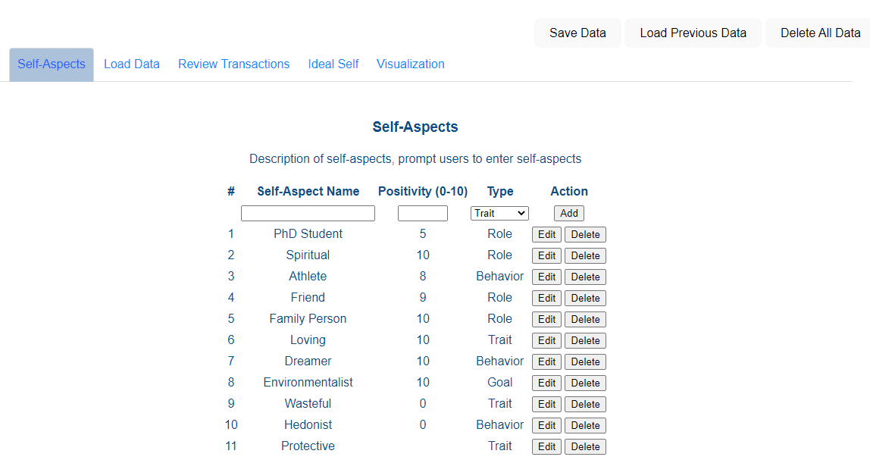
Self-Aspect Elicitation

Slide 92
Annotate Transactions

Slide 93
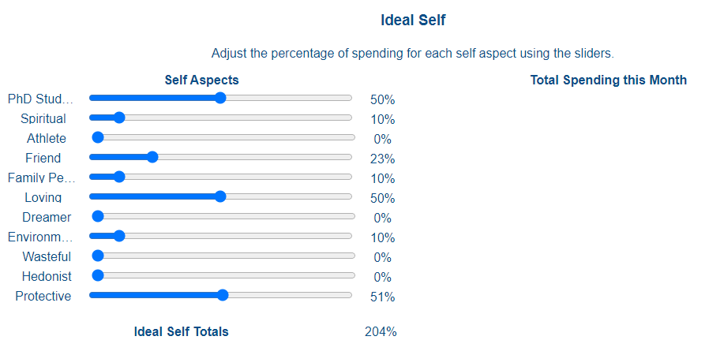
Construct “Ideal Self”

Slide 94
Visualize Results

Slide 95
Study Details
Participants do this for 2 concurrent months
First time, think-aloud study to understand how they think about annotating transactions
Look at data to check for evidence of change
% change in spending across need/self-aspect categories from month to month
% change in built-in Mint categories from month to month
This might be infeasible for the study

Slide 96
Publication Details
Findings focused around the think-aloud portion of understanding how individuals reflect on their financial transactions
Also include design recommendations for personal informatics systems for finances
May consider anonymizing transactions in a way that would allow for publication of annotated transactions
Use categories
Generalize spending to $10 increments
Intended publication venue: CHI 2023, or DIS 2024

Slide 97
Open Questions for Discussion
I am debating between having individuals annotate their financial transactions with one (or more) of the following:
Values (from the Rokeach Value Survey or SVS)
Self-aspects (requires having participants complete the self-aspect elicitation activity)
Needs satisfied (Max-Neef's theory, or self-determination theory)
For the study design, I am thinking about a pre-post study, to see if the exercise has any resulting change in spending habits. The conclusions will likely be more qualitative than quantitative, given the smaller sample size and likely high variance in spending patterns across individuals.
I am generally struggling with representing the many-to-many relationship between "need satisfied" (or "value reified" or "self-aspect activated") and "money spent." For example, saying that one spent 40% of their money on "freedom" could hide the fact that part of the 40% also likely reified other values/self-aspects/needs.

Slide 98
Background and Related Work
Research Approach
Value-Aligning Personal Informatics
Study 1 – Understanding Human Need
Study 2 – Personal Financial Informatics
Study 3 – Empathy Viz Survey
Timeline and Discussion

Slide 99
Beyond the Individual
This kind of data collection and reflection useful at the individual level, what about beyond the individual?
In study 1, people wanted to share the data

Slide 100
Participants from Study 1 Want to Share
“The closest person in my life, my wife or my kids, they deserve to know how I have lived my life. So that these kids don't end up making the same mistakes that I've made. When they get to see the visualization of me, their father, I think it goes to show them the kind of person I am, and the kind of person they would like to become…they would be able to decide for themselves what they want to do” –P7
“I think I would want to share this with people just to show them like, `hey look, look at where you are in this network', either like to celebrate their place in my life or to say, hey, maybe we should do this more, or maybe we should do this less.” –P9

Slide 101
Research Goal
To what extent can representations of individuals' daily lives support empathy?
3a. In what ways do individuals suggest they might want to use visualizations of their daily life to share with others?
3b. How well does different information about an individual's activities and perceived need satisfaction in a given day effectively communicate the lived experience to another person? (who is a stranger)
3c. How do individuals make sense of information/visualizations about a stranger's day?

Slide 102
Survey Design
We have activity-need data from study 1, with annotations of daily satisfaction ratings
What happens if a stranger is shown this intimate data? (anonymized)
Can they pick out which day was better?
What exactly leads to effective “empathy”?
Three conditions:
List of activities
List of needs satisfied (by duration)
Timeline showing activities and needs satisfied

Slide 103


Slide 104


Slide 105


Slide 106

Visualizations
Treatment 1: Just a timeline of activities
Treatment 2: Just a timeline of hours of need satisfaction
Treatment 3: Timeline visualization with activities and the needs satisfied

Slide 107
Expected Contributions
Understanding how well lifestyle data can help individuals understand others
Highlight usefulness for reflection data beyond individual
Understanding what visualization/information is helpful for supporting empathy
Visualization design suggestions
Target publication: CHI 2024 or CSCW 2024

Slide 108
Open Questions for Discussion
The three-group RCT design is intended to piece apart how knowledge of activities vs. perception of needs satisfied vs. putting them together in a visualization leads to more or less alignment with original participant self-views.
Is there a better way to create treatments that better address the RQ?
Given that the visualizations for the survey are coming from such a small number of "original participants" (from Study 1), the results may not be very generalizable.
Is it necessary to do some initial analysis that looks for correlations across need satisfaction ratings and day satisfaction ratings? (IE, what actual statistical relationships exist in the data, before trying to have people discern them via the visualizations?)
Would it make sense to do some kind of visualization design workshop? I already have a sense of visualizations I plan to use for the survey, but curious about conducting a user-centered visualization workshop.

Slide 109
Background and Related Work
Research Approach
Value-Aligning Personal Informatics
Study 1 – Understanding Human Need
Study 2 – Personal Financial Informatics
Study 3 – Empathy Viz Survey
Timeline and Discussion

Slide 110
Overall Expected Contributions
Designing Personal Informatics Systems
Implementing “new” psychological theories/methods into personal informatics systems
Day Reconstruction Method, Multiple Self-Aspects, Max-Neef, Rokeach/Schwartz
New model of reflection at multiple scales (global self + quanta of everyday life)
Useful for pre-contemplation stage behavior change
Scaffolds reflection on data collected by PI systems
New application areas – needs, self-aspects, financial transactions
Software engineering / designing databases to implement systems

Slide 111
Overall Expected Contributions
Creating Representations/Visualizations of the Self
Network model of need satisfaction
Network visualizations of everyday life
For personal use
For interpersonal use

Slide 112
Overall Expected Contributions
Improved understanding of how people think about everyday life
Challenges of using Max-Neef’s theory of needs
Understanding the experience of self in everyday life
Understanding how people assign values to financial transactions
Understanding what makes for a “good day” and how that can be communicated

Slide 113
Potential Broader Impacts
Releasing applications for immediate use
Method for scalable needs assessment to implement sustainable consumption corridors
Tools for use in therapy
Tools for strengthening relationships

Slide 114
Future Work
Aggregating data from multiple individuals
Lifestyle recommender systems
Person-to-person
Big data – tracking lifestyle trajectories
AI Alignment
Creating machine-readable representations of a meaningful human life

Slide 115

Timeline
Notes:
Don’t have everything end in September
Have things spread out over the next year
Overlay job search tasks
Show entire thing – when will we check back in.

Slide 116
Thank you!

Slide 117
Closing Discussion

Slide 118
Backup

Slide 119

Collective Results
Notes:
what’s our theory of need? Self-as-needs, self-as-consumption

Slide 120
Collective Results
Notes:
what’s our theory of need? Self-as-needs, self-as-consumption

Slide 121
Personal Informatics
Notes:
Self-tracking, personal informatics, quantified self. Tracks both objective (largely via sensors) and subjective (via self-report).
https://www.google.com/url?sa=i&url=https%3A%2F%2Fwww.fitbit.com%2Fglobal%2Fus%2Fproducts%2Fsmartwatches%2Fversa&psig=AOvVaw3D6tG0EQGdw6c3hm4ArluP&ust=1638302835072000&source=images&cd=vfe&ved=0CAwQjhxqFwoTCOjztuavvvQCFQAAAAAdAAAAABAD
https://www.google.com/url?sa=i&url=https%3A%2F%2Ftechnori.com%2F2018%2F08%2F4281-the-beginners-guide-to-quantified-self-plus-a-list-of-the-best-personal-data-tools-out-there%2Fmarkmoschel%2F&psig=AOvVaw2D91lQMZzOHQ1xR0iacY4P&ust=1638302862070000&source=images&cd=vfe&ved=0CAwQjhxqFwoTCKCQtfSvvvQCFQAAAAAdAAAAABAD
https://www.google.com/url?sa=i&url=https%3A%2F%2Fmint.intuit.com%2F&psig=AOvVaw0jNtQUAQEkHRVOfhXYpZ-x&ust=1638302936030000&source=images&cd=vfe&ved=0CAwQjhxqFwoTCIip8JawvvQCFQAAAAAdAAAAABAD
https://www.google.com/url?sa=i&url=https%3A%2F%2Fwww.happierhuman.com%2Fbest-mood-tracker-apps%2F&psig=AOvVaw2Pa9KFjdSoazhX9Jk6auoD&ust=1638302906270000&source=images&cd=vfe&ved=0CAwQjhxqFwoTCNC4krGwvvQCFQAAAAAdAAAAABAD

Slide 122


Personal informatics largely built upon the transtheoretical model of behavior change
Notes:
https://www.google.com/url?sa=i&url=https%3A%2F%2Fwww.researchgate.net%2Ffigure%2FTranstheoretical-Model-stages-of-behavior-change-Note-Adapted-from-Prochaska-J_fig2_267096772&psig=AOvVaw2ZLJl8yU8PdK6QonlrQVWO&ust=1638303106042000&source=images&cd=vfe&ved=0CAwQjhxqFwoTCIDT0OuwvvQCFQAAAAAdAAAAABAJ

Slide 123


Li’s Stage Based Model of PI

Slide 124


Epstein’s “Lived Informatics” Model of PI

Slide 125


Where is the “Self” in Quantified Self?
Only briefly mentions the multiplicity of the self, motivates further exploration

Slide 126
Personal Informatics Theories and Methods
Theories of the Self
Personal Informatics for
Self-Development
Theories of Self-Development
Methods for Eliciting Self-Repot
Visualization and Mental Models
Self-as-Needs application to sustainability

Slide 127


Theories of the Self
Three Components:

Slide 128

Constituents of the Self
Network Structure of the Self
MSF
Notes:
Self is composed of “aspects” which are generally vague, but are associated with certain contexts.
Each aspect is associated with relevant attributes:
Traits (ie, talkative) • Behaviors (ie, questioning) • Physical Characteristics (ie, tall) • Affect (ie, moody)

Slide 129
Evolving Self
Dynamic Network Structure of the Self
Past Self
Current Self
Future Self
Notes:
Self is composed of “aspects” which are generally vague, but are associated with certain contexts.
Each aspect is associated with relevant attributes:
Traits (ie, talkative) • Behaviors (ie, questioning) • Physical Characteristics (ie, tall) • Affect (ie, moody)

Slide 130


Self-Feelings
Mood seen as an evaluation of perceived ability to meet future demands
Notes:
MFA says that self-evaluations impact affect.
This is related with

Slide 131
Self-Seeking and Self-Preservation
We seek to maintain our sense of self, and seek desired future or “ought” selves

Slide 132
In summary: our views of ourself effect our affective states and behavior The self can be conceptualized as a network of components

Slide 133
What might it mean to “develop” oneself?

Slide 134
Personal Informatics Theories and Methods
Theories of the Self
Personal Informatics for
Self-Development
Theories of Self-Development
Methods for Eliciting Self-Repot
Visualization and Mental Models
Self-as-Needs application to sustainability

Slide 135

Kegan’s Theory of Development
More and more content is shifted from “subject” to “object’
Note also the emphasis on “structure of meaning making”
Notes:
https://www.google.com/url?sa=i&url=https%3A%2F%2Fazatris.github.io%2Flevels&psig=AOvVaw1Ef8LaJKdqKLWmHqIs2IVS&ust=1638305792689000&source=images&cd=vfe&ved=0CAwQjhxqFwoTCKjiu-i6vvQCFQAAAAAdAAAAABAt

Slide 136


Kegan’s Theory of Development
Notes:
https://www.google.com/url?sa=i&url=https%3A%2F%2Fmedium.com%2F%40NataliMorad%2Fhow-to-be-an-adult-kegans-theory-of-adult-development-d63f4311b553&psig=AOvVaw1Ef8LaJKdqKLWmHqIs2IVS&ust=1638305792689000&source=images&cd=vfe&ved=0CAwQjhxqFwoTCKjiu-i6vvQCFQAAAAAdAAAAABAz

Slide 137


Kegan’s Theory of Development
“Mindsets” or mental models change through the stages
Notes:
https://www.google.com/url?sa=i&url=https%3A%2F%2Fmedium.com%2F%40NataliMorad%2Fhow-to-be-an-adult-kegans-theory-of-adult-development-d63f4311b553&psig=AOvVaw1Ef8LaJKdqKLWmHqIs2IVS&ust=1638305792689000&source=images&cd=vfe&ved=0CAwQjhxqFwoTCKjiu-i6vvQCFQAAAAAdAAAAABAz

Slide 138


Fowler’s Stages of Faith
Faith is...
“...our way of finding coherence in and giving meaning to the multiple forces and relations that make up our lives...a person’s way of seeing him- or herself in relation to others against a background of shared meaning and purpose”
www.rodwhite.net
Notes:
https://www.google.com/url?sa=i&url=https%3A%2F%2Fwww.rodwhite.net%2Fstages-of-faith-earth-wind-fire-water%2F&psig=AOvVaw3g67BlipXH1PE72qqUT7K-&ust=1638306688359000&source=images&cd=vfe&ved=0CAwQjhxqFwoTCPDv45O-vvQCFQAAAAAdAAAAABAX

Slide 139
Fowler’s Contents of Faith
Faith is...
Centers of Value
Images of Power
Master stories
The “Contents” of meaning making
Faith meant to be universal – no religious requirement
Notes:
https://www.google.com/url?sa=i&url=https%3A%2F%2Fwww.rodwhite.net%2Fstages-of-faith-earth-wind-fire-water%2F&psig=AOvVaw3g67BlipXH1PE72qqUT7K-&ust=1638306688359000&source=images&cd=vfe&ved=0CAwQjhxqFwoTCPDv45O-vvQCFQAAAAAdAAAAABAX

Slide 140
This stuff is all “in our heads”
How do we “get it out”?

Slide 141
Personal Informatics Theories and Methods
Theories of the Self
Personal Informatics for
Self-Development
Theories of Self-Development
Methods for Eliciting Self-Repot
Visualization and Mental Models
Self-as-Needs application to sustainability

Slide 142

Retrospective Report
Attempt to recover episodic memories that have already been incorporated into global schema
Suffers from “unsystematic forgetting”

Slide 143
Methods for Eliciting Self-Report
Verbal protocols (talk-aloud, think-aloud)
Experience Sampling Methodology (ESM)
Day Reconstruction Method (DRM)
Development interviews (subject-object interview, Fowler interview)

Slide 144
Report Type by Retrospective-ness, event duration, and cognition
Type 1 (direct stream of conscious)
Type 2 (verbal encoding required)
Type 3 (additional cognitive process involved)
Up to a lifetime
Development Interviews
The duration of time reported about
1 day
Day Reconstruction Method
Experience Sampling
0 seconds
Talk-aloud
Think-aloud
0 seconds
Fraction of Second
0-12 hours
Seconds
Up to a lifetime
Time between event and capture of report (“retrospectiveness”)

Slide 145
Report Type by Retrospective-ness, event duration, and cognition
Type 1 (direct stream of conscious)
Type 2 (verbal encoding required)
Type 3 (additional cognitive process involved)
Up to a lifetime
Development Interviews
The duration of time reported about
1 day
Day Reconstruction Method
Experience Sampling
0 seconds
Talk-aloud
Think-aloud
0 seconds
Fraction of Second
0-12 hours
Seconds
Up to a lifetime
Time between event and capture of report (“retrospectiveness”)

Slide 146


Talk-Aloud and Think-Aloud
Talk-aloud
Think-aloud
Talk aloud – capturing stream of consciousness (type 1)
Think aloud – requires some verbal encoding of thoughts (type 2)
Type 3 – some other mediating cognitive process

Slide 147
Report Type by Retrospective-ness, event duration, and cognition
Type 1 (direct stream of conscious)
Type 2 (verbal encoding required)
Type 3 (additional cognitive process involved)
Up to a lifetime
Development Interviews
The duration of time reported about
1 day
Day Reconstruction Method
Experience Sampling
0 seconds
Talk-aloud
Think-aloud
0 seconds
Fraction of Second
0-12 hours
Seconds
Up to a lifetime
Time between event and capture of report (“retrospectiveness”)

Slide 148


Experience Sampling
Experience Sampling
Random samples of what it’s like “in the moment”
Some cognitive interruption from phone/timer/text
Mitigates issues with retrospective report

Slide 149
Report Type by Retrospective-ness, event duration, and cognition
Type 1 (direct stream of conscious)
Type 2 (verbal encoding required)
Type 3 (additional cognitive process involved)
Up to a lifetime
Development Interviews
The duration of time reported about
1 day
Day Reconstruction Method
Experience Sampling
0 seconds
Talk-aloud
Think-aloud
0 seconds
Fraction of Second
0-12 hours
Seconds
Up to a lifetime
Time between event and capture of report (“retrospectiveness”)

Slide 150


Day Reconstruction Method
Day Reconstruction Method
Daily “diary like” study
Participant determines epochs of a day (“episodes”)
Participant reports on each episode (affect, activity, etc.)
Attempts to approximate ESM, with the added benefit of creating a complete time budget

Slide 151
Report Type by Retrospective-ness, event duration, and cognition
Type 1 (direct stream of conscious)
Type 2 (verbal encoding required)
Type 3 (additional cognitive process involved)
Up to a lifetime
Development Interviews
The duration of time reported about
1 day
Day Reconstruction Method
Experience Sampling
0 seconds
Talk-aloud
Think-aloud
0 seconds
Fraction of Second
0-12 hours
Seconds
Up to a lifetime
Time between event and capture of report (“retrospectiveness”)

Slide 152

Development Interviews
Development Interviews
Almost like a therapy session
Subject object interview (SOI) pushes one ‘to the edges of meaning making’ to determine present forms of mind
An intervention in itself!
Fowler does a ‘life reconstruction method’

Slide 153
Self-Report Summary
Methods vary in retrospective-ness, duration, and mental content reported on
Methods require different intervening cognitive processes (esp. type 3)
Researcher must be clear what they are asking the individual to report on

Slide 154
Personal Informatics Theories and Methods
Theories of the Self
Personal Informatics for
Self-Development
Theories of Self-Development
Methods for Eliciting Self-Repot
Visualization and Mental Models
Self-as-Needs application to sustainability

Slide 155
Reciprocal Feedback Loops
Visualizations and mental models inform and construct each other
We form mental models of the visualizations
So what would it mean if we visualize ourselves?

Slide 156


Networks for Visualizing the Self
The “Self” is a complex system
networks visualize complex systems
networks can visualize the self

Slide 157

Psychological Research Methods as Intervention
“Being on the edge of our sensemaking can be transformative... and a tool like the SOI [Subject object interview] can support someone to stand at the edge of their sensemaking and look out over the uncharted terrain of the future”
Modified for gender inclusivity

Slide 158
Framework for PI and Self-Development
Confront mental models with viz
External Representation(s) of Self
Reflection
Visualization
Reflection prompts
Reflection results
PI System
Objective data about life

Slide 159
Personal Informatics Theories and Methods
Theories of the Self
Personal Informatics for
Self-Development
Theories of Self-Development
Methods for Eliciting Self-Repot
Visualization and Mental Models
Self-as-Needs application to sustainability

Slide 160
“A point may soon be reached...when these needs are satisfied in the sense that we prefer to devote our further energies to non-economic purposes.”

Slide 163
Challenge:
“Development that meets the needs of the present without compromising the ability of future generations to meet their own needs”

Slide 164
Sustainable Consumption Corridors

Slide 165
Sustainable Consumption Corridors:
Key open challenges for operationalizing consumption corridors:
“potential strategies for the design”
“definition and implementation of such corridors”
Need implementation-focused theory to operationalize consumption corridors

Slide 166


Slide 167
What are human needs?
Nobody seems to agree
Notes:
https://www.i4biz.com/best-practice/win-compete-top-maslows-hierarchy-needs/

Slide 168
Key Takeaways from Theories of Need
Needs (universal) v. satisfiers (culturally dependent)
Participative (involved those being measured)
PI system for mediating participative needs assessment
Notes:
https://www.i4biz.com/best-practice/win-compete-top-maslows-hierarchy-needs/

Slide 169
Self-as-Needs
Two entities (needs and satisfiers)
+ complex relationships between needs and satisfiers
→ bipartite network representation of an individual’s needs (need landscape)
Notes:
what’s our theory of need? Self-as-needs, self-as-consumption

Slide 170
Self-as-Needs
Notes:
https://www.i4biz.com/best-practice/win-compete-top-maslows-hierarchy-needs/

Slide 171
What might it mean to develop the self-as-needs?
Notes:
what’s our theory of need? Self-as-needs, self-as-consumption

Slide 172
Speculation warning!
Notes:
what’s our theory of need? Self-as-needs, self-as-consumption

Slide 173
What might it mean to develop the self-as-needs?
socialized need landscape
self-authoring need landscape
transforming need landscape (?)
Notes:
what’s our theory of need? Self-as-needs, self-as-consumption

Slide 174
What might it mean to develop the self-as-needs?
Shifting one’s needs and satisfiers from subject to object
Seeing one’s needs and satisfiers as the needs and satisfiers of one individual in a larger social system
Notes:
what’s our theory of need? Self-as-needs, self-as-consumption

Slide 175


PI for Self-as-Needs Development
External Representation(s) of Self
Confront mental models with viz
Reflection
Visualization
Reflection prompts
Reflection results
PI System
Objective data about life

Slide 176
Potential Use Cases
Individual reflection and development
Identify over-satisfied and under-satisfied needs
Understand more financially (and environmentally) efficient ways of living with equal (or greater) satisfaction
Creating artifacts for facilitating sharing “what life is like” for someone (improved empathy and connection)
Learning from others “how to live”
Potential metric of progress for social system caretakers (government leaders, HR departments, neighborhood associations)

Slide 177
Networks can be aggregated
“Individual as Network”
Represent group as a network to highlight systematic need deficiencies
Compare social systems
Notes:
https://www.i4biz.com/best-practice/win-compete-top-maslows-hierarchy-needs/

Slide 178
Open Questions
What happens when you ask someone about their needs and satisfaction? How useful are these constructs?
Empirical landscape of perceived need and satisfaction
What visualization provides an effective mapping from mental models of the self to visualizations of the self?
How do individuals currently think about their “needs”
How does confronting a visualization of the self lead to positive change and self-development?
What would it mean to develop the self-as-needs?
How can this development support long term sustainability
Notes:
https://www.i4biz.com/best-practice/win-compete-top-maslows-hierarchy-needs/

Slide 179
Acknowledgements
Committee: Prof. Stephen Voida (advisor), Prof. Tammy Sumner, Prof. Leaf Van Boven
Fellow students: Janghee Cho, Abbie Zimmerman-Niefield, Bryce Schumacher, Ian Van Buskirk, Sam Zhang, Julie Hayes, Elizabeth Spaulding, Peter Johnsen
Notes:
https://www.i4biz.com/best-practice/win-compete-top-maslows-hierarchy-needs/

Slide 180
Discussion
Notes:
https://www.i4biz.com/best-practice/win-compete-top-maslows-hierarchy-needs/

Slide 181
Backup
Notes:
https://www.i4biz.com/best-practice/win-compete-top-maslows-hierarchy-needs/

Slide 182
Self-Report on Needs
Could utilize survey-based reflection
Day reconstruction method for scaffolding reflection on need satisfaction activities
Experience sampling (“what are you doing? What need(s) are you meeting?”)
Visualization authoring system facilitates reciprocal feedback

